Slide 1
Minimum Wage in Japan institutional aspects and its consequences
Ryo Kambayashi
Institute of Economic Research, Hitotsubashi University
Workshop on minimum wages
Lessons from recent experiences and European perspectives
20th Oct. 2017, Paris

Slide 2
What I will talk today …
Institutional aspects of Japanese minimum wage
Its consequences
  Employment loss?
  Association with polarization
  Some evidence on wage compression
Lessens from the Japanese case

Slide 3
(A) Institutional aspects
Universality
Geographical zoning
Centralized bargaining
  result in
Various ‘bites’ between groups

Slide 4
(A) Institutional aspects
(a) Universality
[almost] No exemption
  ANY employment contract in Japan must satisfy the minimum wage.
    Contractors and self-employment is NOT covered.
  No automatic exemption
    Even trial jobs or apprenticeship are subject to mw as long as they are employed.
  Employers of disable worker can apply individually for the exemption [14,619 in 2012]

Slide 5
(A) Institutional aspects
(b) Geographical zoning
Determined by Prefecture-level
  47 prefecture
    The border of prefecture is not likely to be artificial. Most of them has been kept since feudal era.
  Cf.) Negligible industry-level minimum wage
    Potentially covers only 3.1 million workers in 2015 (less than 3% of total number of employee)

Slide 6
(A) Institutional aspects
(c) Centralized bargaining
Two stage bargaining
  Central Council for Minimum Wage determines “four standards” of minimum wage hike.
    6 university professors, 6 union representatives, 6 employer association representatives.
    They classify 47 prefectures into 4 areas (rank A to D), and determine the “standards” of mw hike for each area.
    For example, on 27th July 2017, the central council determines that “+26 (JPY) for rank A, +25 for rank B, +24 for rank C, and +22 for rank D.”

Slide 7
(A) Institutional aspects
(c) Centralized bargaining
Two stage bargaining
  Prefectural Council for Minimum Wage determines the actual minimum wage hike.
    Usually only accept its “standard” that the central council had determined for (almost independent from local economic conditions).
    Cf.) Econometrically, the Japanese institution provides the exogenous variation of mw.

Slide 9
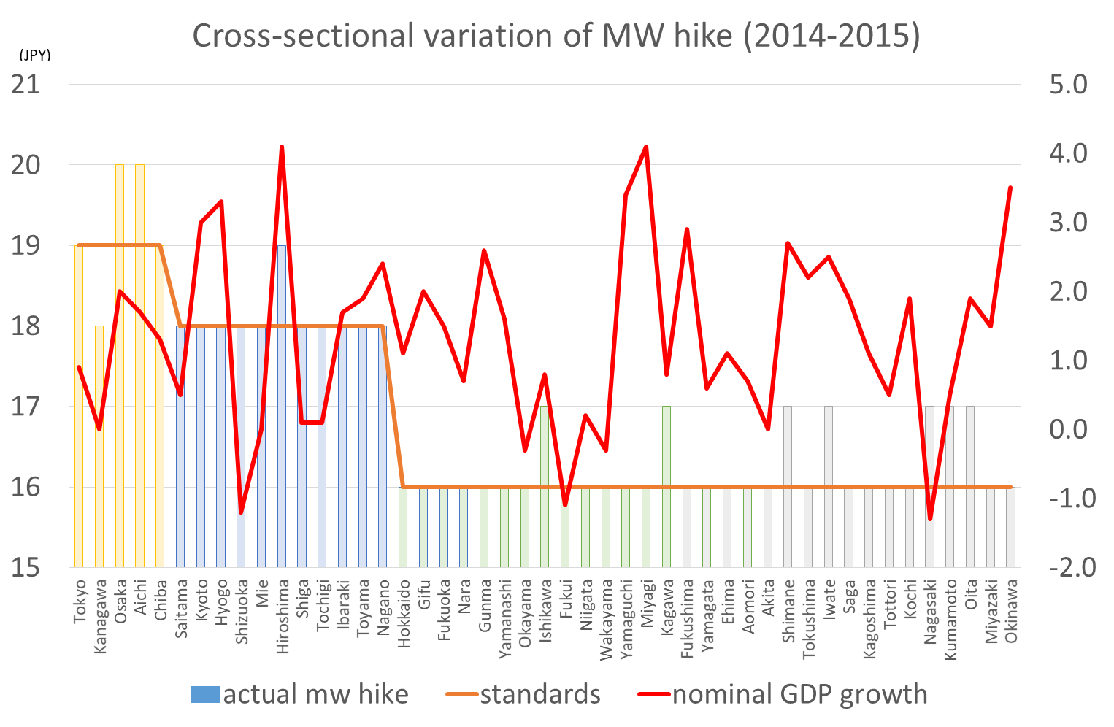

Slide 10
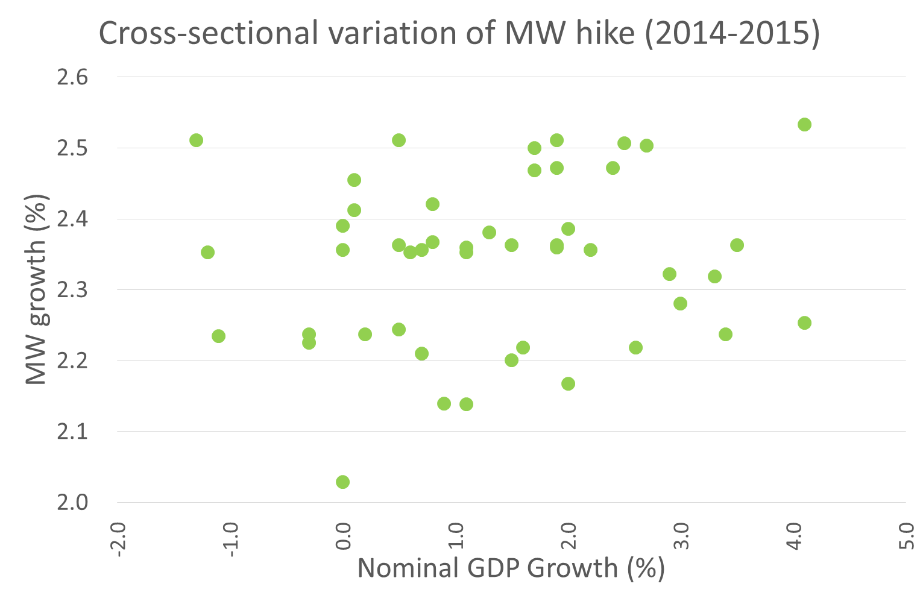

Slide 11
(A) Institutional aspects
(d) Different ‘bites’
Proportion of MW to Median Wage
  Level
    Higher in Female than in Male
    Higher in Big-City than in Country-side
  Time series trend
    The timing of increasing trend is earlier in Country-side than in Big-City.
    Recent increasing trend is much faster in Big-City than in Country-side (which comes from the 2017 amendment).

Slide 12
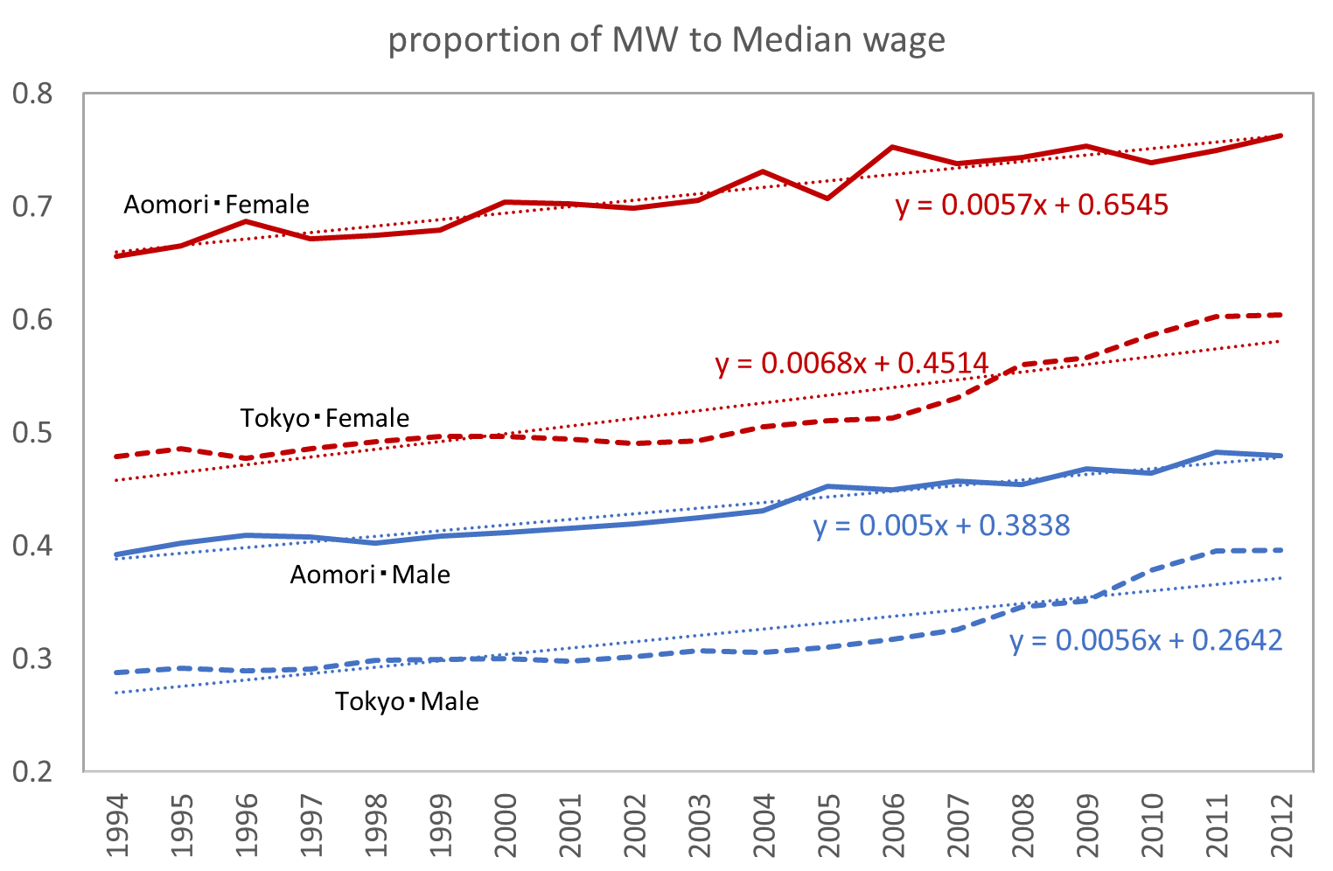

Slide 13
(A) Institutional aspects
Universality
Geographical zone
Centralized bargaining
  result in
Various ‘bites’ between groups
  = Advantageous for economic analysis [because of its exogeneity], but we should be careful about negative consequences of minimum wage hike.

Slide 14
(B) Its consequences
Employment loss?
Relation to polarization
Wage compression

Slide 15
(B) Its consequences
(a) Employment loss?
Data limitation
  The sample size of LFS (CPS equivalent) is too small to produce prefecture-level employment sizes (0.05% of population on average).
  Use Employment Status Survey (ESS)
    1% from population (over 1M in a year)
    But
    Once five year
    ‘Usual’ base questionnaire (not actual base)
      {Mainly working, Mainly Schooling/Housework, Non-employed}

Slide 16
(B) Its consequences
(a) Employment loss?
Outcome variables
  Employment
    Usual employment status
    Job quality
  [Training (Hara, 2017, Labour Economics)]
Econometric Model
$${Outcome}_{jt}^{k}={β^{k}∙MW}_{jt}+{dummy_pref}_{j}^{k}+{dummy_yr}_{t}^{k}\left(+{trend}_{j}^{k}\right)$$

Slide 17
$${Emp}_{jt}^{k}={β^{k}∙MW}_{jt}+{dummy_pref}_{j}+{dummy_yr}_{t}$$
Prefecture j : 1-47
Year t: 1997, 2002, 2007, 2012
Group k: gender*education*age (2*2*11)

Slide 18
$${Emp}_{jt}^{k}={β^{k}∙MW}_{jt}+{dummy_pref}_{j}+{dummy_yr}_{t}$$
Prefecture j : 1-47
Year t: 1997, 2002, 2007, 2012
Group k: gender*education*age (2*2*11)

Slide 19
$${Emp}_{jt}^{k}={β^{k}∙MW}_{jt}+{dummy_pref}_{j}+{dummy_yr}_{t}+{trend}_{j}$$
Prefecture j : 1-47
Year t: 1997, 2002, 2007, 2012
Group k: gender*education*age (2*2*11)

Slide 20
$${Emp}_{jt}^{k}={β^{k}∙MW}_{jt}+{dummy_pref}_{j}+{dummy_yr}_{t}+{trend}_{j}$$
Prefecture j : 1-47
Year t: 1997, 2002, 2007, 2012
Group k: gender*education*age (2*2*11)

Slide 21
$${NonEmp}_{jt}^{k}={β^{k}∙MW}_{jt}+{dummy_pref}_{j}+{dummy_yr}_{t}+{trend}_{j}$$
Prefecture j : 1-47
Year t: 1997, 2002, 2007, 2012
Group k: gender*education*age (2*2*11)

Slide 22
$${NonEmp}_{jt}^{k}={β^{k}∙MW}_{jt}+{dummy_pref}_{j}+{dummy_yr}_{t}+{trend}_{j}$$
Prefecture j : 1-47
Year t: 1997, 2002, 2007, 2012
Group k: gender*education*age (2*2*11)

Slide 23
(B) Its consequences
(a) Employment loss?
Minimum wage hike does not always decrease jobs in prefecture.
  If there be job loss effects, it may be concentrated in lower educated female people.
  ※ Further discussion is needed because of the inconsistency between employment-loss and discouraged effect

Slide 24
(B) Its consequences
(b) Relation to polarization
ESS provides industry * occupation information
  Define 3,483 jobs by industry (3 digit) * occupation (3 digit) (average # of observation: 293.2)
  Classify each job into three bins by 2002 (national) median wage of job.
  Measure the growth of each bin between 2002 and 2012 by prefecture.

Slide 25
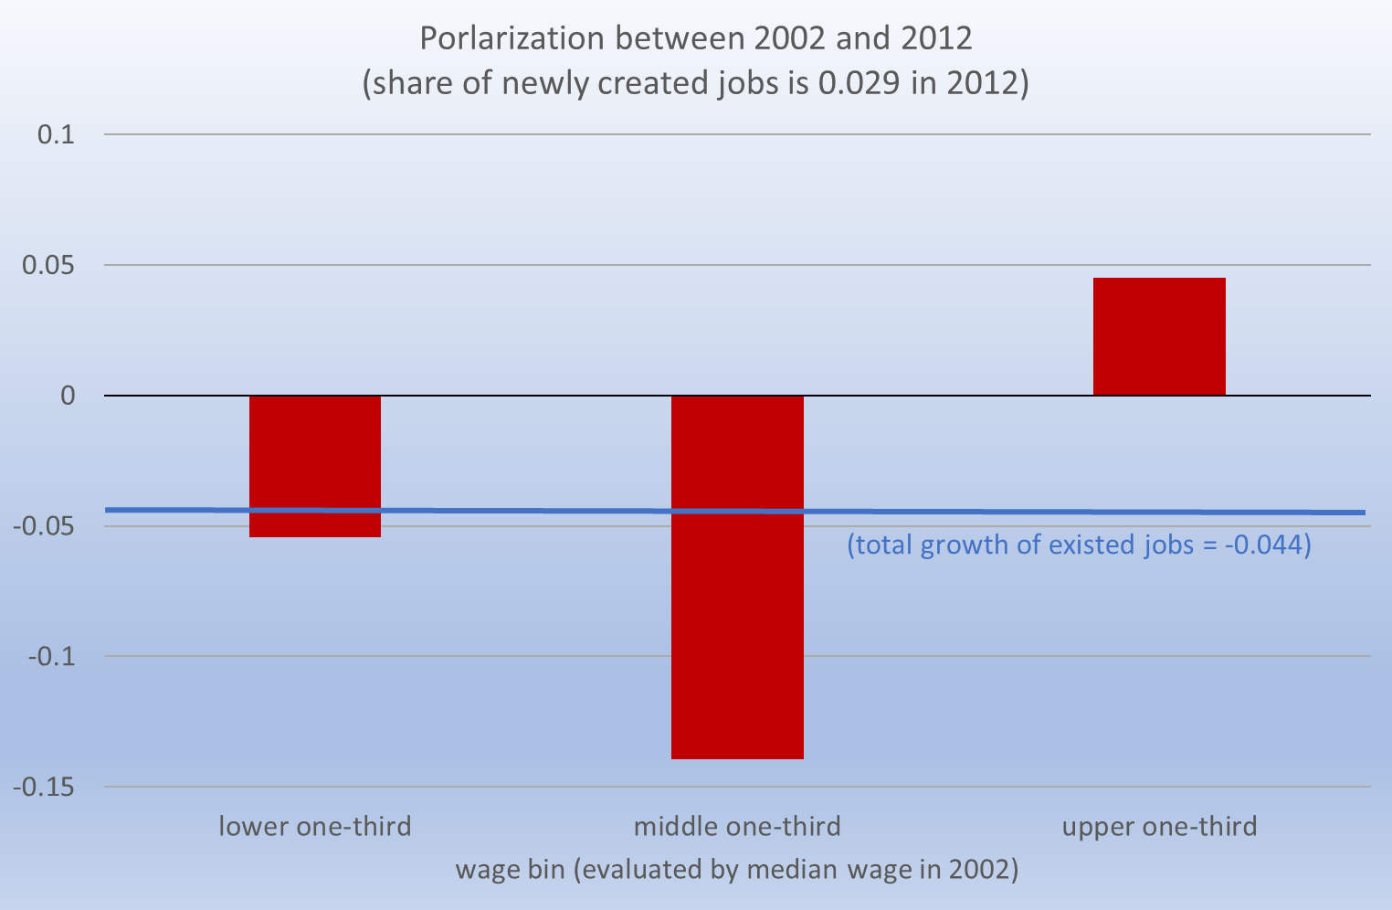

Slide 26
(B) Its consequences
(b) Relation to polarization
ESS provides industry * occupation information
  Define 3,483 jobs by industry (3 digit) * occupation (3 digit) (average # of observation: 293.2)
  Classify each job into three bins by 2002 (national) median wage of job.
  Measure the growth of each bin between 2002 and 2012 by prefecture.
Regress each bin growth on mw hike.
$${∆emp}_{j}^{b}={dummy_bin}^{b}+{β∙∆MW}_{j}+{crossterm}_{j}^{b}$$

Slide 27

$${∆emp}_{j}^{b}={dummy_bin}^{b}+{β∙∆MW}_{j}+{crossterm}_{j}^{b}$$

Slide 28
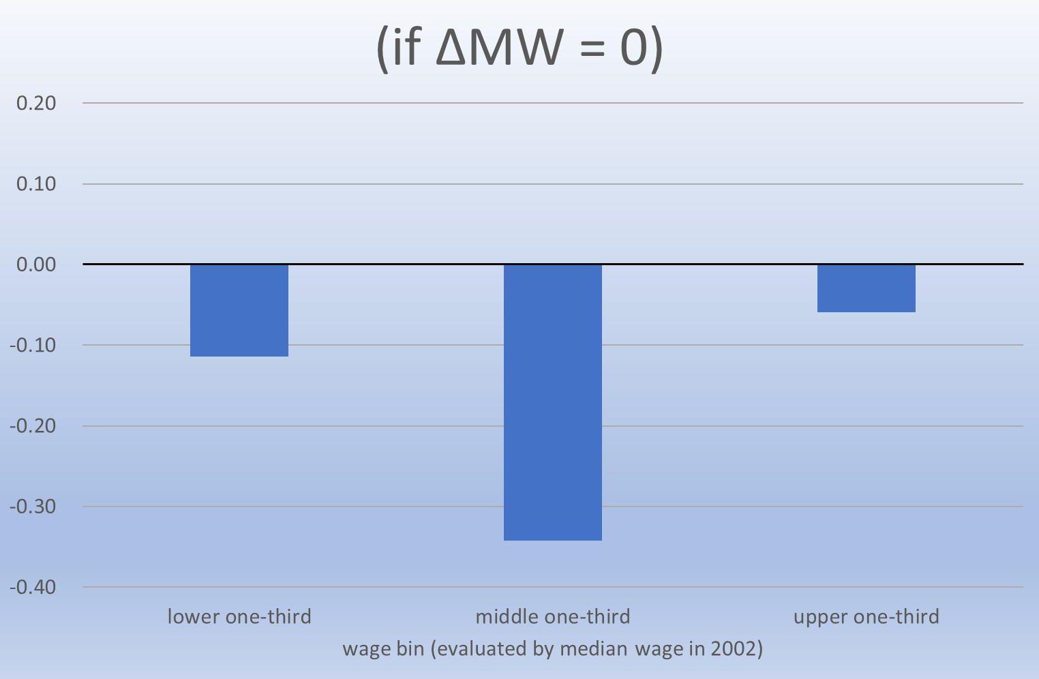
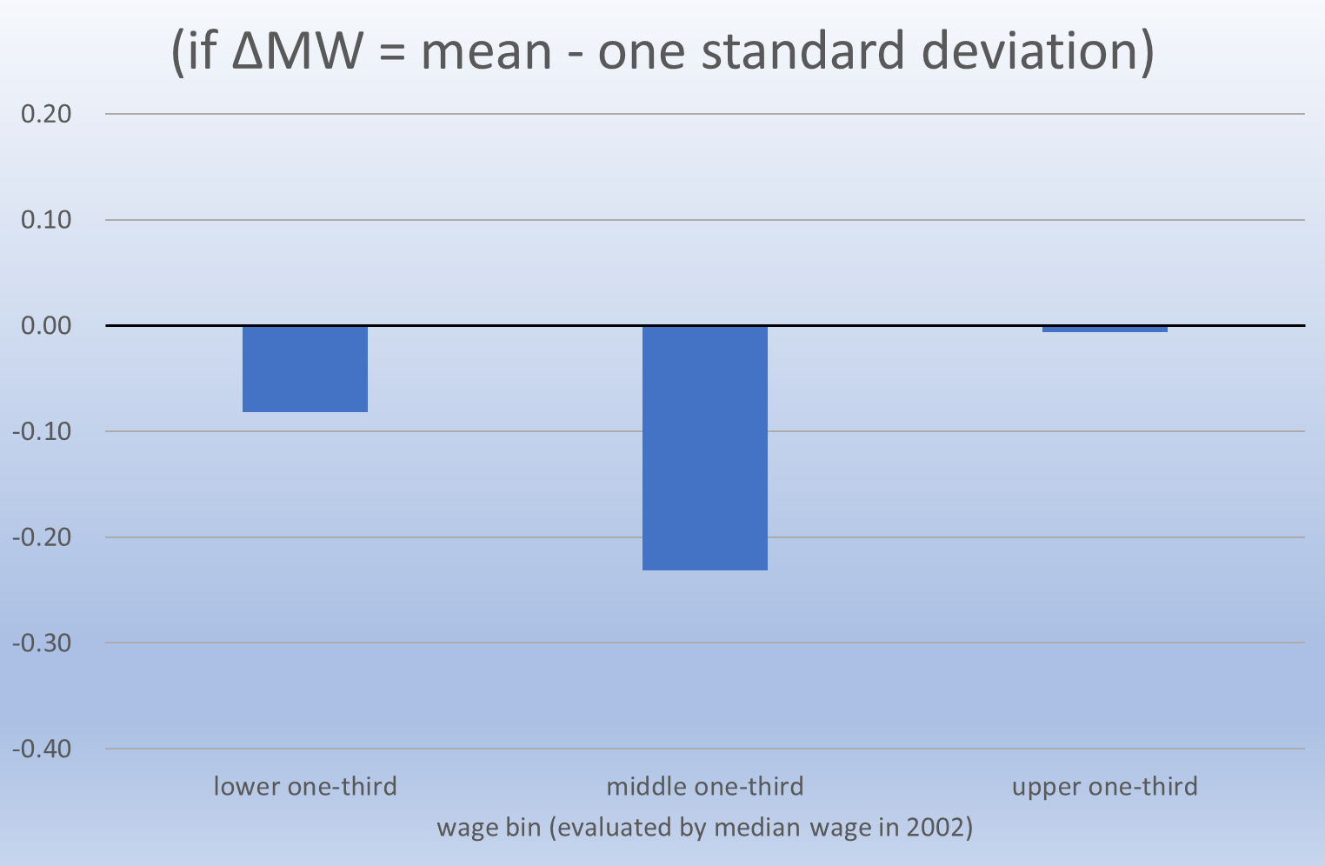
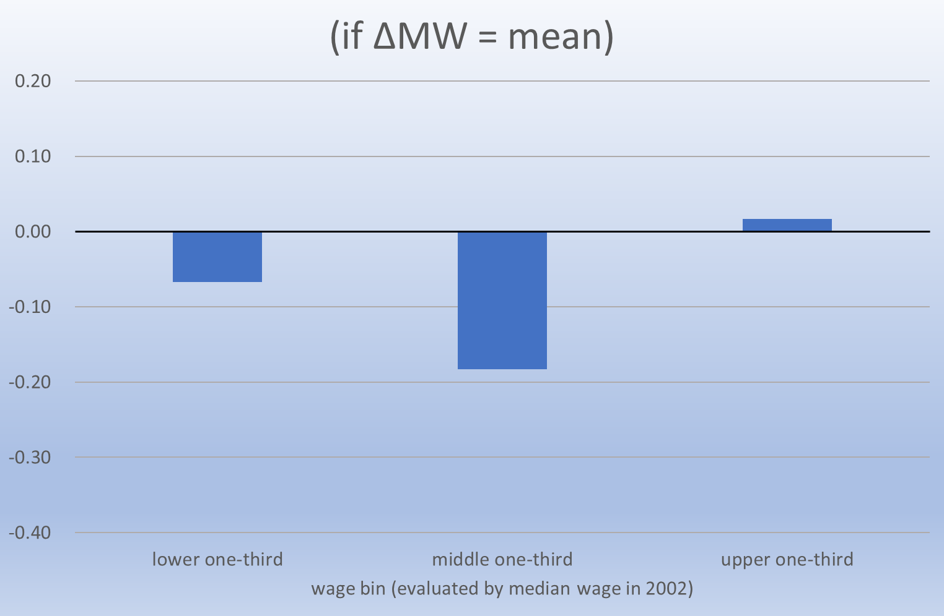
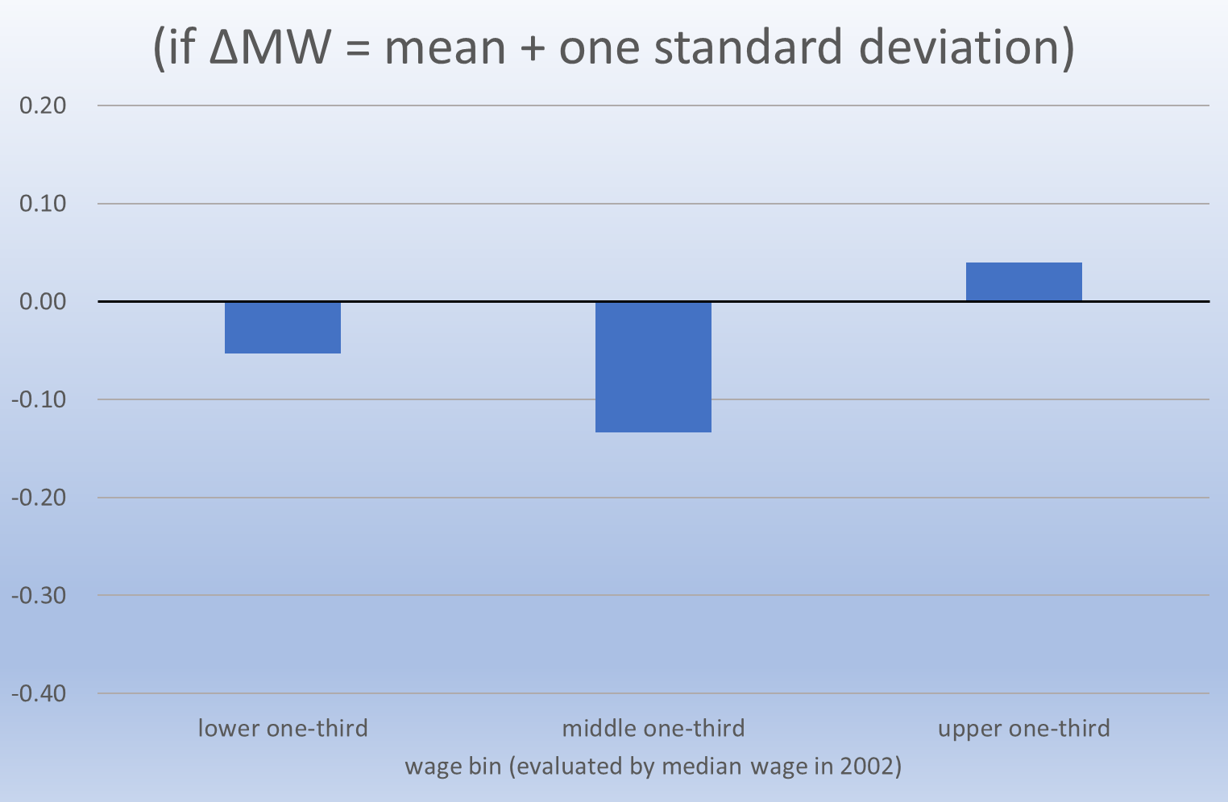
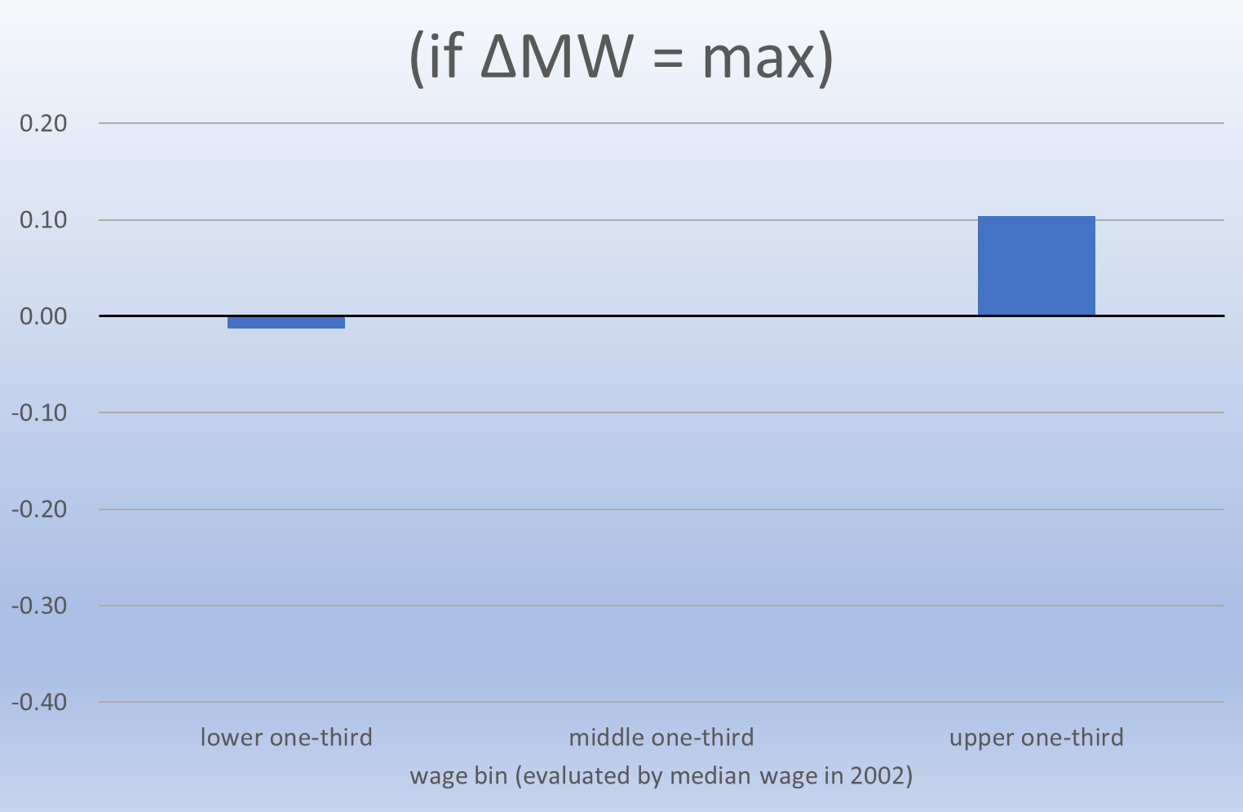

Slide 29
(B) Its consequences
(b) Relation to polarization
Rising minimum wage may be associated with mitigating polarization.
  though still needs to be investigated (Remember, we did not control for prefecture-specific trend in this section).

Slide 30
(B) Its consequences
(c) Wage compression

Slide 31
(B) Its consequences
(c) Wage compression

Slide 32
(B) Its consequences
(c) Wage compression

Slide 33
(B) Its consequences
(c) Wage compression

Slide 34
(B) Its consequences
(c) Wage compression
Apparent compression of wage distribution due to minimum wage hike.
  During 1990s, only in female & low-rank prefecture
  Recently, even in male & Tokyo
⇒Implies some spillover effect by mw

Slide 35
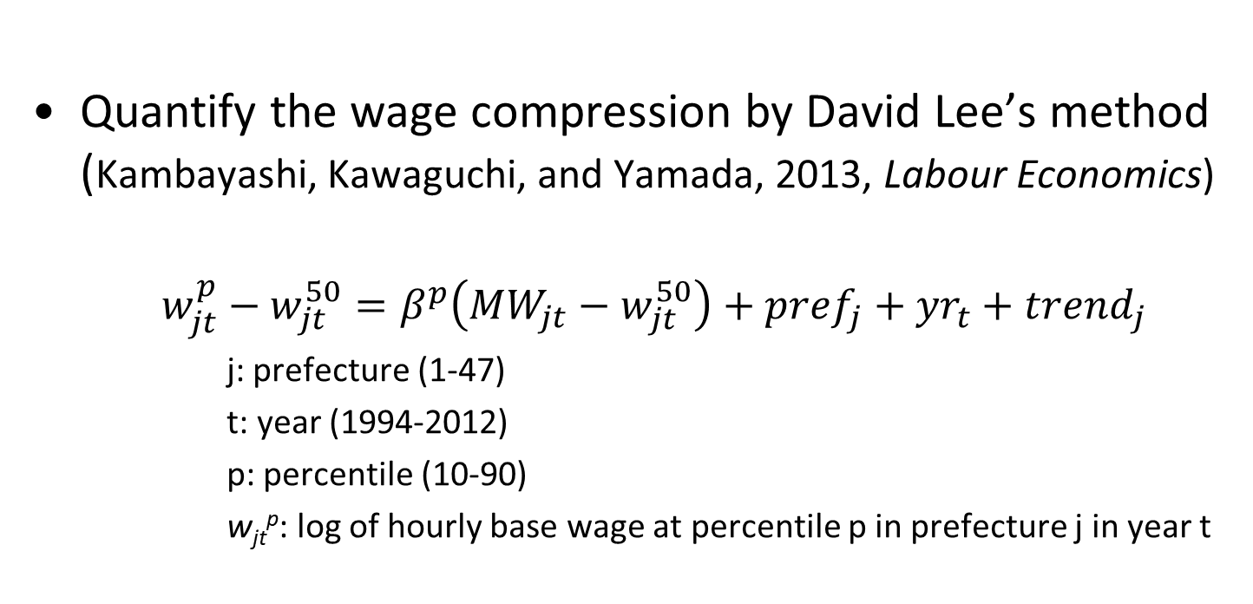
(B) Its consequences
(c) Wage compression
Quantify the wage compression by David Lee’s method (Kambayashi, Kawaguchi, and Yamada, 2013, Labour Economics)
    $$w_{jt}^{p}−w_{jt}^{50}=β^{p}\left({MW}_{jt}−w_{jt}^{50}\right)+{pref}_{j}+{yr}_{t}+{trend}_{j}$$
      j: prefecture (1-47)
      t: year (1994-2012)
      p: percentile (10-90)
      w_{jt}^{p}: log of hourly base wage at percentile p in prefecture j in year t

Slide 36
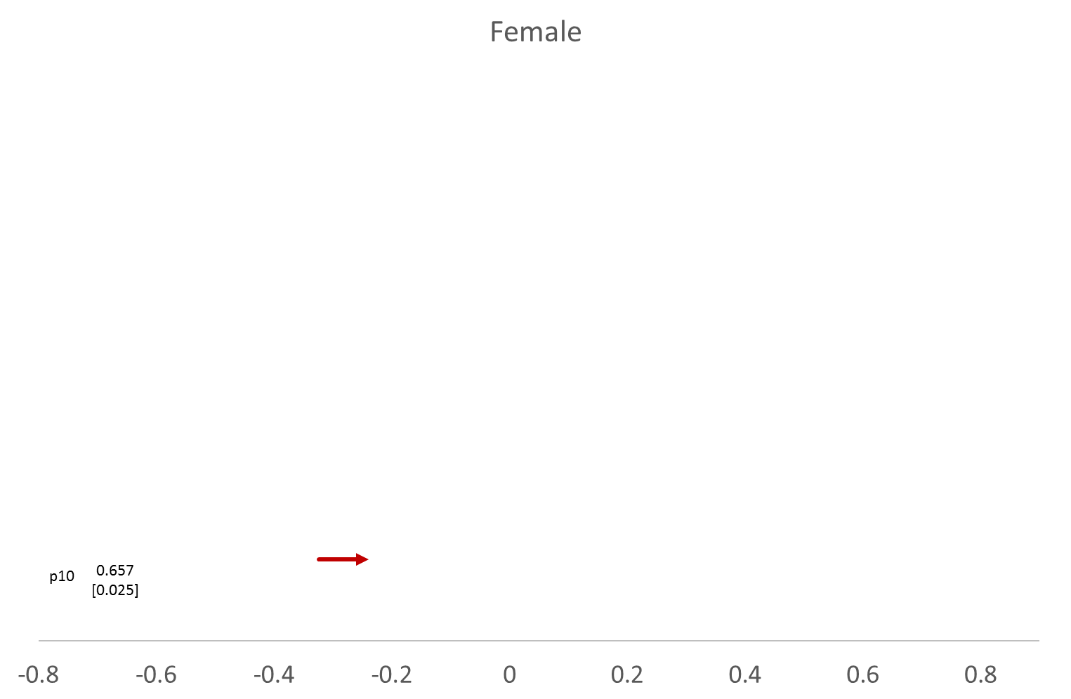
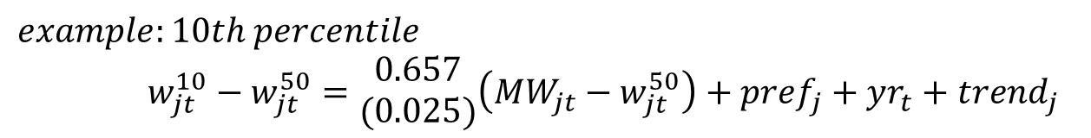
$$example:10th percentile$$
$w_{jt}^{10}−w_{jt}^{50}=\begin{matrix}0.657 \\ (0.025)\end{matrix}\left({MW}_{jt}−w_{jt}^{50}\right)+{pref}_{j}+{yr}_{t}+{trend}_{j}$
In 1994, average relative 10th percentile (w¹⁰₁₉₉₄-w⁵⁰₁₉₉₄) was -0.323.
Since, between 1994 and 2012, average change in relative MW (MW_{t}-w⁵⁰_{t}) was +0.128,
the compression effects: 0.657*0.128=+0.084
Median

Slide 37
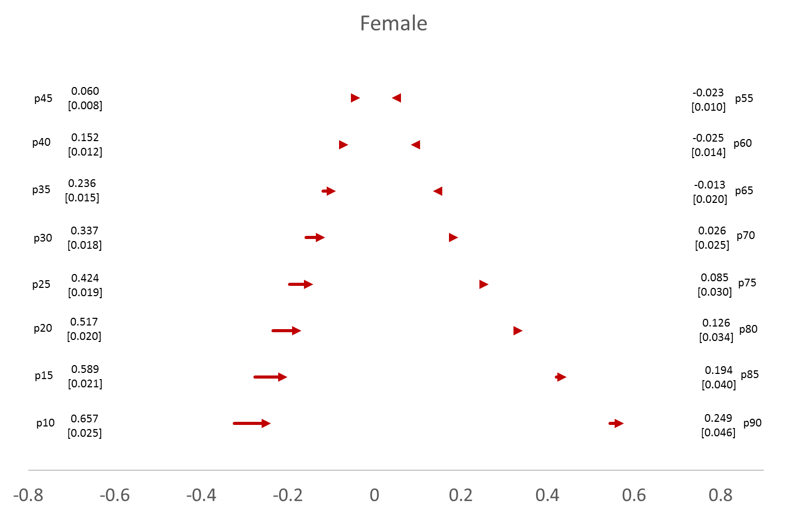
Median

Slide 38
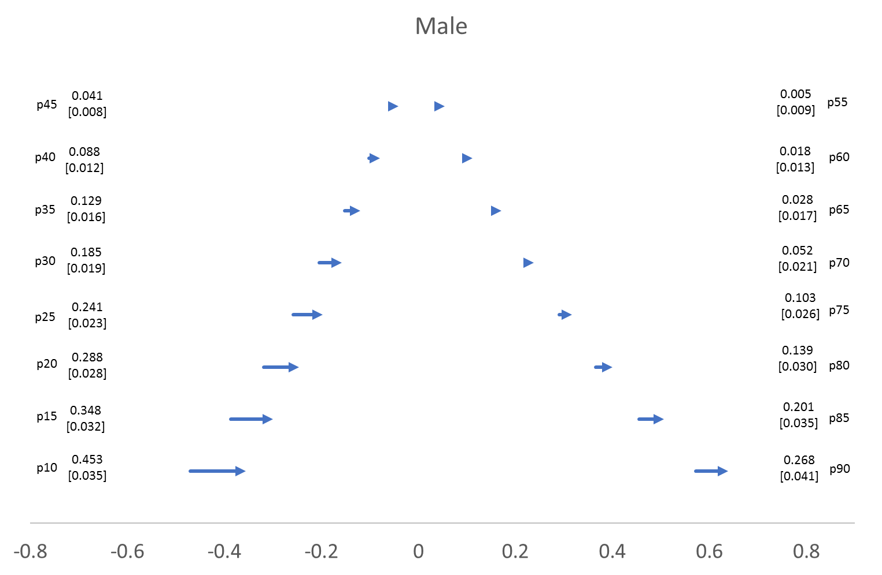
Median

Slide 39
(B) Its consequences
Employment loss?
  Slightly YES, but we do not find major employment loss.
Relation to polarization
  Rising mw is associated with a transformation from polarization to up-grading in terms of job quality.
Wage compression
  Rising mw is strongly associated with the compression of lower tail of wage distribution.

Slide 40
(C) Lessens from the Japanese case
Given the Japanese labor market situation, Minimum Wage hike does not conclude the apparent negative consequences.
  Next question: is it due to…
    the low level of mw (the relative position was 0.3 to 0.4)
    Sufficient informal sector (the employee’s ratio in population was over 10% even during 1990s)

