Slide 1
THE ORIGINS OF HAPPINESS
Andrew E. Clark
(Paris School of Economics - CNRS)
Sarah Fleche
(London School of Economics)
Richard Layard
(London School of Economics)
Nattavudh Powdthavee
(Warwick Business School)
George Ward
(MIT)
30/3/2017. Journee du Bonheur.

Slide 2
AIM
We wanted to try to understand the big (well-being) picture

Slide 3
  THE NUMBERS
  WE NEED
The effects of everything on wellbeing, where
Wellbeing is measured in a common currency, and
All effects are measured simultaneously
And for the same individual

Slide 4
  THE NUMBERS
  WE NEED
“everything” here includes your childhood and your family background
We don’t want to use recall data
So a lot of our work has been on birth cohorts

Slide 5
THE METRIC:
Life-satisfaction
Democratic (people decide what matters to them)
Valid: it predicts individual future behaviour (quits, divorce, mortality)
Policy-makers like it.

Slide 6
LIFE-SATISFACTION (LS)
AFFECTS VOTING
Incumbent vote share
= 0.64 LS
+ 0.36 Economic Growth
- 0.06 Unemployment
+ 0.15 Inflation
(β coefficients)
Source: Eurobarometer. Ward, CEP DP 1343.

Slide 7
Determinants of adult life-satisfaction
Family and schooling
Child outcomes
Adult
situation
Adult life-satisfaction
Income
Parenting
Family break-up
Mother’s mental health
Schooling
Intellectual
Behavioural
Emotional
Income
Education
Employment
Family
Crime
Physical health
Mental
health
Life-satisfaction

Slide 8
OUR EVIDENCE
1.Birth cohort studies
British Cohort Study (1970)
ALSPAC (1991/2)

Slide 9
2.Annual panel studies of adults
British Household Panel Survey
German SOEP
Australian HILDA
Also US (BRFSS).

Slide 10
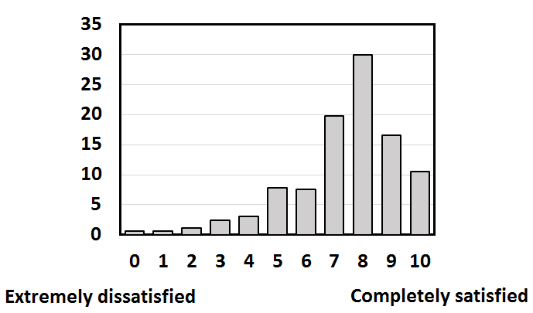
Distribution of life-satisfaction

Slide 11
British Cohort Study
Over 17000 people born in England, Scotland and Wales in a single week in 1970.
At age 34: 8,868 obs.
Aim: Explain adult life-satisfaction (0-10) at age 34: “How dissatisfied or satisfied are you about the way your life has turned out so far?”
We explain life-satisfaction by seven adult outcome variables (AO), three sets of childhood characteristics(CO), and family characteristics (F).

Slide 12
Adult outcomes (AO)
Economic | Log income (equivalised) Educational achievement Employed (measured as not unemployed) | at 34 by 34 at 34
Social | Good conduct (= -no. of crimes) Has a partner | at 16-34 at 34
Personal | Self-perceived health Emotional health | at 26 at 26

Slide 13
British Cohort Study
Adult Emotional Health is measured by 24 Yes/No questions relating to tiredness, depression, worry, irrational fear, rage, irritation, tension and psychosomatic symptoms.
Can also use a variable for having seen a doctor for emotional problems.

Slide 14
We measure emotional health and self-perceived health at age 26 rather than at 34
This avoids the charge that these are synonyms of life-satisfaction rather than predictors of it

Slide 15
Distal variables include those from the child (CO) and their parents (“family background”: F)
We consider three main dimensions of child development – intellectual performance, social behaviour and emotional health (these are the three relevant childhood counterparts to the seven adult AO’s described above)

Slide 16
These three are distinct from each other
Social behaviour relate to destroying things, fighting, stealing, disobedience, lying, bullying, being disliked and unsettled and impulsive behaviour.
Questions on children’s emotional health are more internal, and relate to worry, unhappiness, sleeplessness, eating disorder, bedwetting, fearfulness, school avoidance, tiredness, and psychosomatic pains.

Slide 17
The BCS data provide us with measurements on the three child variables at ages 5, 10 and 16.
We also have measurements on the family at different ages
For simplicity we consolidate these into one overall measure for each of the X_{C} and F₀ variables (composite variables make the tables easier to read)

Slide 18
Childhood and Family Variables
 | Age of child
Child characteristics
Intellectual performance | 5, 10, 16
Good conduct | 5, 10, 16
Emotional health | 5, 10, 16
Family background
Economic
Father’s socio-economic group | 10
Family income | 10
Number of siblings | 10
Father in work | 0, 5, 10 average
Mother’s and father’s age on leaving full-time education | --
Psycho-social
Mother’s emotional health | 5, 10 average
Child conceived within marriage | --
Both parents still together | 10

Slide 19
Analysis is by OLS
Variables (except gender) are standardised throughout. Thus all coefficients are standardised regression coefficients (β-coefficients).
Missing indicator method for missing right-hand side variables (multiple imputation produces the same results).

Slide 20
Life-satisfaction and adult outcomes
LS on AO: Partial correlation coefficients x100
 | Using adult variables only
Log income Educational achievement Employed Good conduct Has a partner Self-perceived health (26) Emotional health (26) (Female) | 5.5 3.5 8.5 6.6 11.6 6.8 20.4 (6.8)

Slide 21
AVERAGE Life satisfaction AND MISERY (Lowest 10%) ARE EXPLAINED BY THE SAME ao’S
 | Life-satisfaction β | Misery β
Income | 0.09 | -0.07
Education (years) | 0.02 | -0.01
Not unemployed | 0.06 | -0.07
Non criminality | 0.06 | -0.04
Partnered | 0.11 | -0.08
Physical health (no. of conditions) | 0.10 | -0.09
Mental health (diagnosed depression/anxiety) | 0.19 | -0.16
R² | 0.19 | 0.14

Slide 22
Life-satisfaction, childhood outcomes and family
LS on CO and F: Partial correlation coefficients x100
Using childhood variables only
Intellectual performance (5, 10, 16) Good conduct (5, 10, 16) Emotional health (5, 10, 16) Family economic Family psychosocial (Female) | 4.5 8.5 17.4 5.5 3.0 (8.2)

Slide 23
All of adulthood, childhood and family matter
LS on AO, CO and F: Partial correlation coefficients x100
 | Using adult variables only | Using childhood variables only | Using both
Log income | 5.5 |  | 5.2
Educational achievement | 3.5 |  | 2.9
Employed | 8.5 |  | 8.2
Good conduct | 6.6 |  | 6.1
Has a partner | 11.6 |  | 11.3
Self-perceived health (26) | 6.8 |  | 6.5
Emotional health (26) | 20.4 |  | 18.1
Intellectual performance (5 10 16) |  | 4.5 | -3.5
Good conduct (5 10 16) |  | 8.5 | 5.2
Emotional health (5 10 16) |  | 17.4 | 9.8
Family Economic |  | 5.5 | 2.5
Family Psychosocial |  | 3.0 | 2.4
Female | 6.8 | 8.2 | 7.2
Observations | 8,868 | 8,868 | 8,868

Slide 24
Childhood determinants of adult life-satisfaction are stable at different ages

Slide 25
National Child Development Study (17,000 people born in England, Scotland and Wales in a single week of 1958)

Slide 26
Does the child reveal the adult?
At what stage of an individual’s development can we predict their adult outcomes?
The proper test of predictability is the R²s: these appear in the following Table

Slide 27
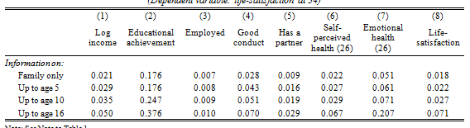
Predicting adult outcomes from
different ages of childhood

Slide 28
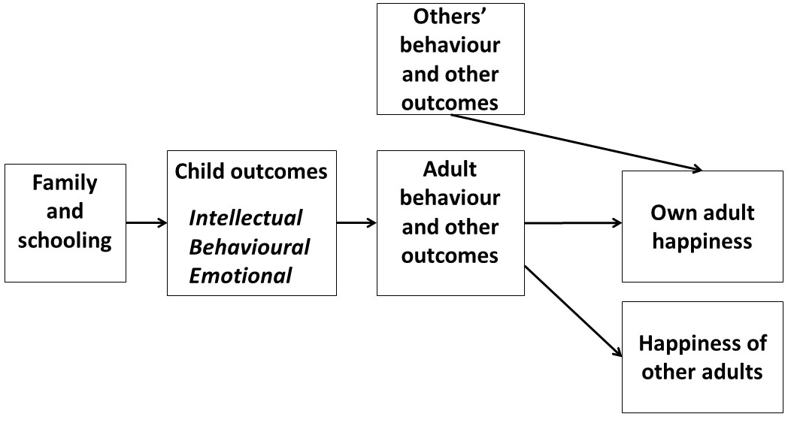
THE NEW element: BEHAVIOUR

Slide 29
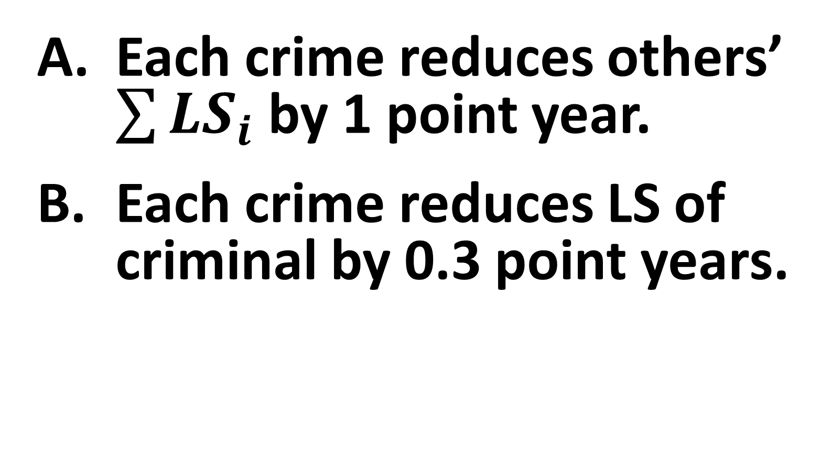
crime
Each crime reduces others’ $\sum{{LS}_{i}}$by 1 point year.
Each crime reduces LS of criminal by 0.3 point years.

Slide 30
SOCIAL INTERACTIONS
In general, what others do may affect my own well-being.
Of course via crime, but also due to social comparisons
We look for these in three large panel datasets

Slide 31
Estimated Effect of log Income
on Life Satisfaction [0-10]: 3 Panels

Slide 32
Income is in natural units (log) here. With a coefficient of 0.15, we estimate that doubling own income will raise life satisfaction by 0.1 of a point on the 0-10 scale.
But will rising income for all raise average well-being in a society?

Slide 33
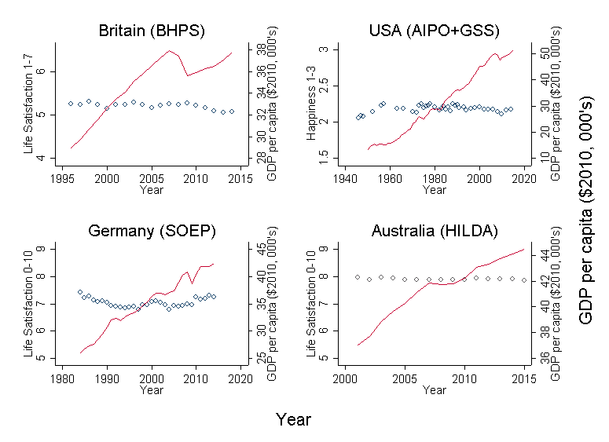
GDP per head and Average Life Satisfaction

Slide 34
Rising GDP per capita may not increase life satisfaction because of either social comparisons, or adaptation to higher levels of income.

Slide 35
Income: Social Comparisons
Social comparisons are estimated to entirely cancel the positive effect of own income in all countries

Slide 36
Income: Adaptation
The estimated coefficients on past income are negative in all countries, but only significant in the SOEP.

Slide 37
Education and Life Satisfaction: 3 Panels
The estimated effect of one more year of education on life satisfaction on a 0-10 scale is also small in the three panels:
BHPS +0.03 points
SOEP +0.05 points
HILDA -0.01 points

Slide 38
Education: Social Comparisons
 | Britain | Germany | Australia
Own education | 0.03 (.00) | 0.05 (.00) | -0.01 (.00)
Others’ education | -0.09 (.02) | -0.05 (.01) | -0.03 (.01)
Comparison education in the cell defined by region*year*age-group. The age groups are 16-30, 31-40, 41-50, 51-60, 61-70 and over 70.

Slide 39
Unemployment and Life Satisfaction: 3 Panels

Slide 40
Unemployment: Social Comparisons
 | Units | Britain | Germany | Australia
Regional unemployment rate | 0-1 | -1.33 (.56) | -1.64 (.36) | -0.38 (.42)
Own unemployment | (1,0) | -0.70 (.04) | -0.99 (.03) | -0.31 (.03)
Others’ unemployment reduces well-being in all countries.
(there is some slight evidence of a social-norm effect of others’ unemployment on those who are unemployed themselves).

Slide 41
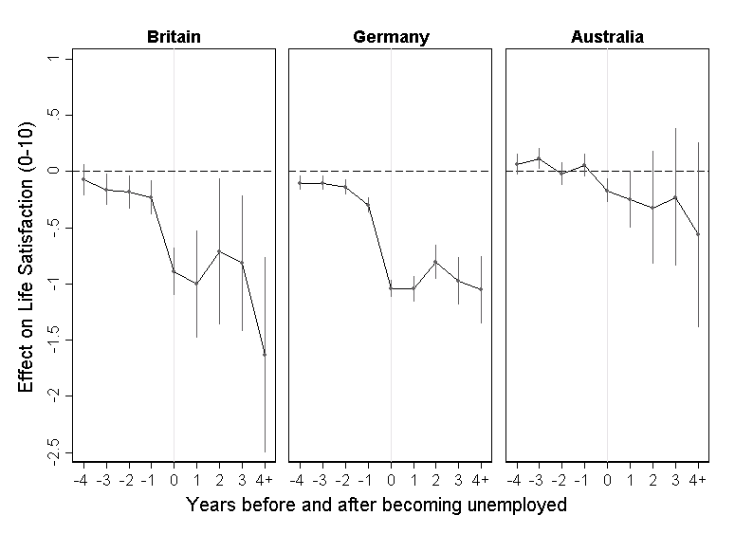
Unemployment: Adaptation
Little adaptation to unemployment

Slide 42
Being with a partner and Life Satisfaction: 3 Panels

Slide 43
Having children and Life Satisfaction: 3 Panels

Slide 44
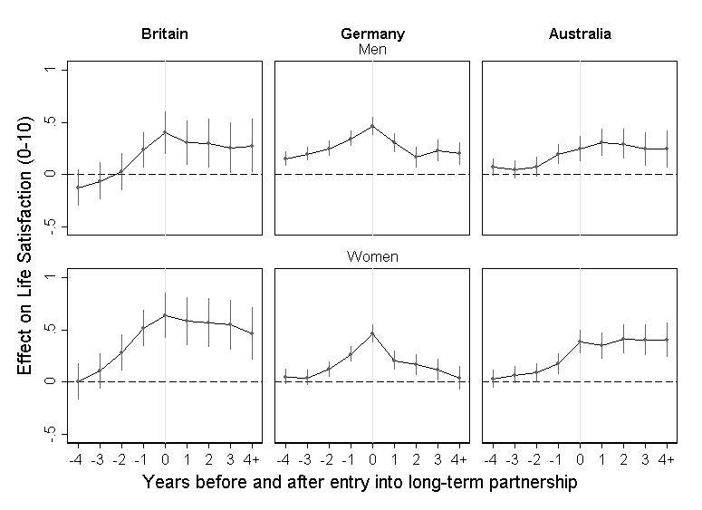
Partnership: Adaptation

Slide 45
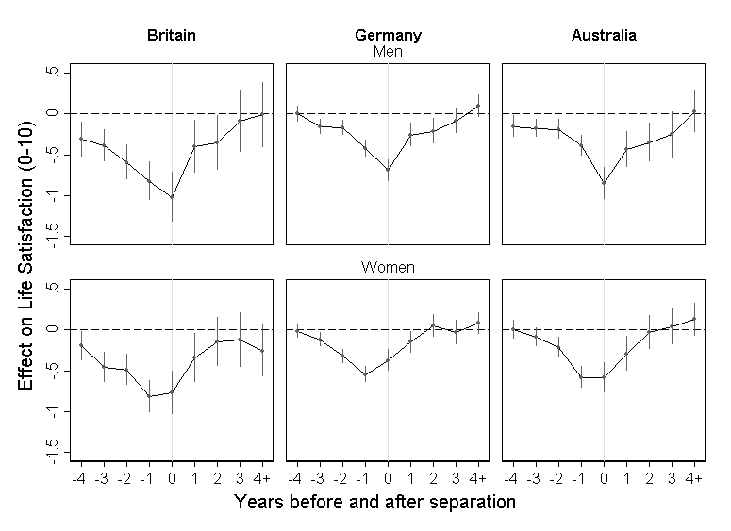
Separation: Adaptation

Slide 46
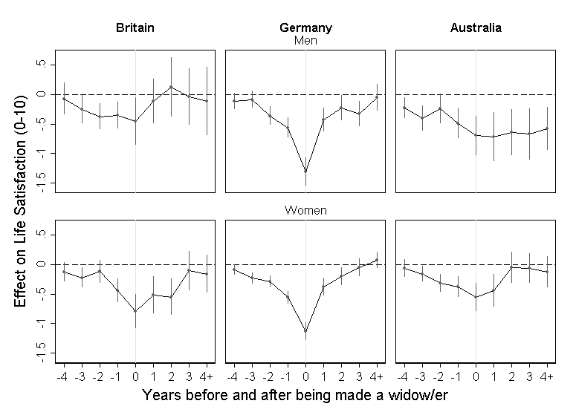
Widowhood: Adaptation

Slide 47
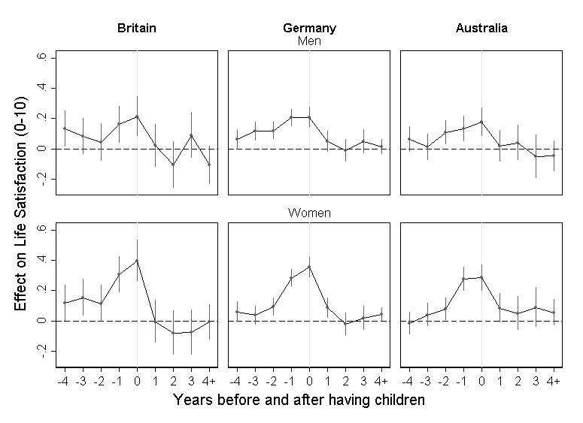
Parenthood: Adaptation

Slide 48
National culture
The analysis of data from one country cannot identify any national culture effect on well-being (as everyone is exposed to it).
We need to compare across countries, using Gallup or WVS

Slide 49
How is national life-satisfaction predicted by different national variables?
β
0.11
0.07
0.20
0.18
0.38
0.24

Slide 50
TURNING TO CHILDHOOD
Childhood emotional health is a strong predictor of adult life satisfaction.
And childhood intellectual performance and behaviour predict specific adult outcomes.
What lies behind these child outcomes?

Slide 51
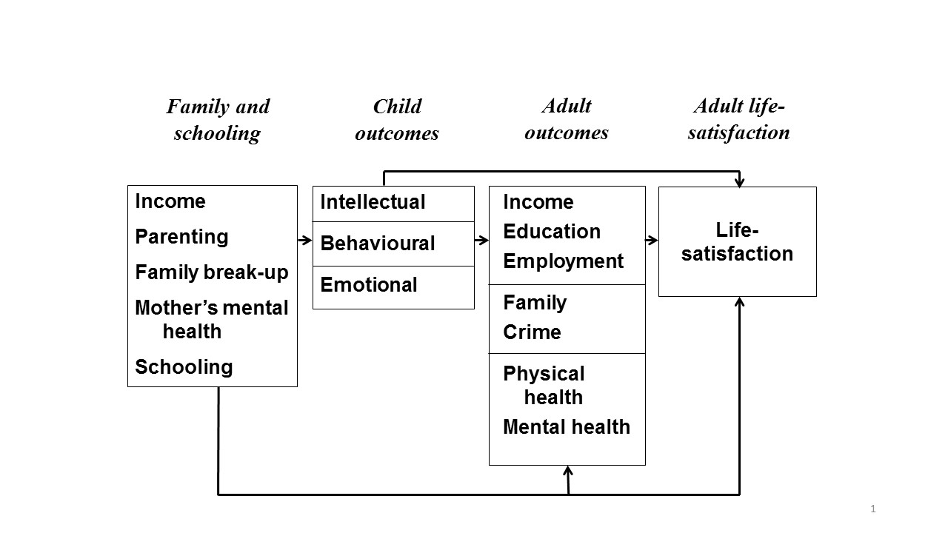

Slide 52
TURNING TO CHILDHOOD
We identify the family correlates of child outcomes using birth cohort data with high frequence of measurement throughout childhood: ALSPAC

Slide 53
ALSPAC data
Avon Longitudinal Study of Parents and Children (“Children of the 90s”): a cohort study that recruited over 14,000 pregnant women who were due to give birth between April 1991 and December 1992 in Bristol and surrounding areas
Sample of 13,978 children alive at 12 months
Very detailed:
  High-frequency reported measures on multiple outcomes
  Multiple observers (parents, child, teachers, clinicians, etc.)
  Data linkage with external sources (e.g. National Pupil Database)
  Clinical data (cognitive and physical measures)
  Bio resources (blood, placenta, saliva, etc. of both parents and children)
  Different types of questionnaires (child-based, child-completed, carer-completed, partner-completed)

Slide 54
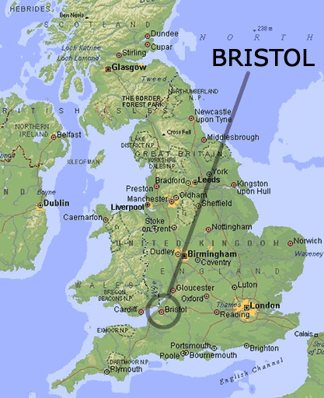
ALSPAC data

Slide 55
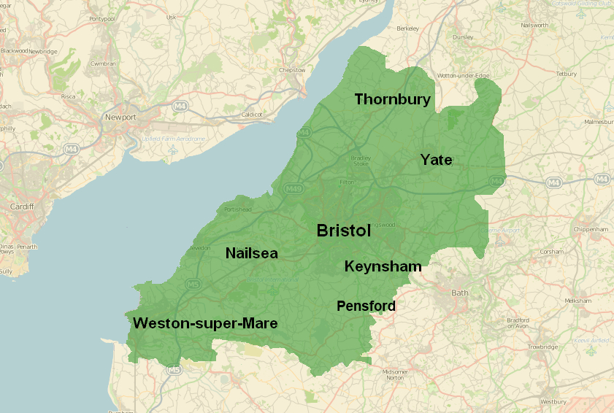
ALSPAC data

Slide 56
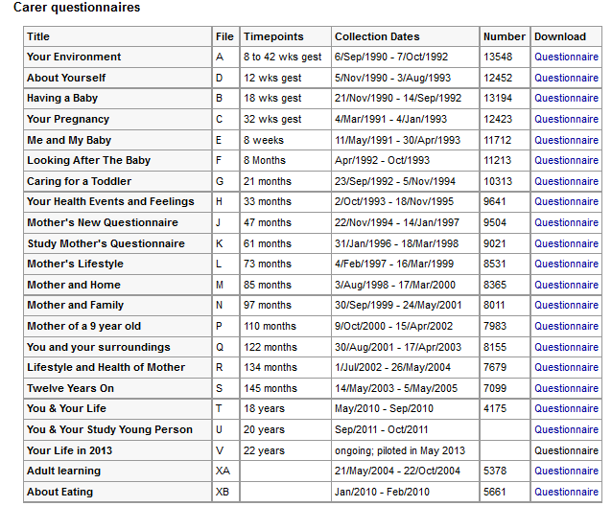

Slide 57
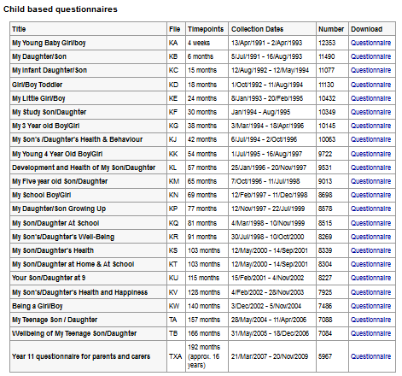

Slide 58
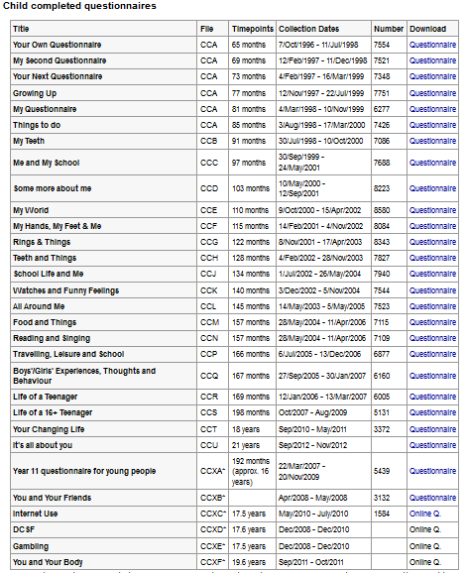

Slide 59
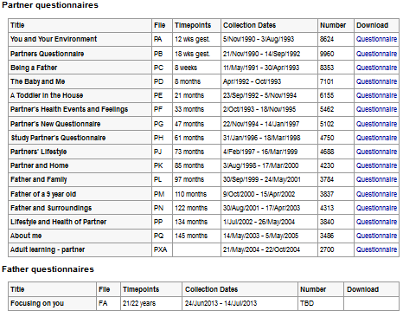

Slide 60
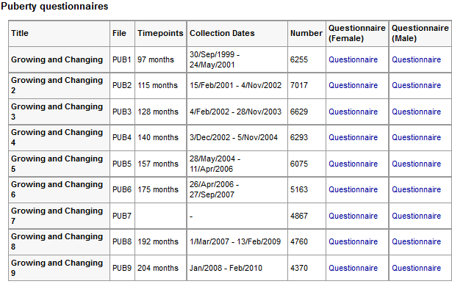

Slide 61
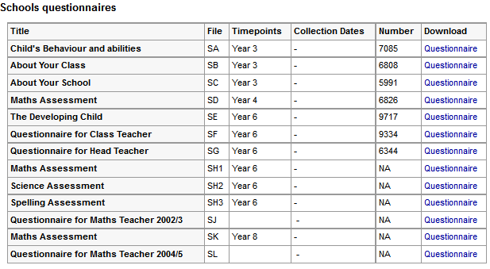

Slide 62
ALSPAC Birth Cohort
Outcome | Age | Measure
Emotional | 16, 11 5 | Short Mood and Feelings Questionnaire, average of replies by mother and child Strengths and Difficulties Questionnaire, mother-assessed
Behavioural | All | Strengths and Difficulties Questionnaire, mother-assessed
Intellectual | 16 11 5 | GCSE points Key Stage 2 Local school entry assessment

Slide 63

How child outcomes are affected by observed family background ($β$ averaged across ages 5, 11, 16)
 | Emotional wellbeing | Behaviour | Intellectual performance
Family income | 0.07 | 0.05 | 0.16
Father's unemployment | -0.03 | 0.00 | -0.02
Mother worked 1st year | -0.02 | 0.00 | -0.02
Mother worked thereafter | 0.00 | -0.03 | 0.05

Slide 64
How child outcomes are affected by observed family background ($β$ averaged across ages 5, 11, 16)
 | Emotional wellbeing | Behaviour | Intellectual performance
Parents’ involvement | 0.05 | 0.09 | 0.04
Parental separation | 0.00 | -0.01 | -0.02
Family conflict | -0.03 | -0.09 | 0.00
Aggressive parenting | -0.04 | -0.16 | -0.01
Father’s mental health | 0.04 | 0.01 | 0.00
Mother's mental health | 0.19 | 0.17 | 0.04

Slide 65
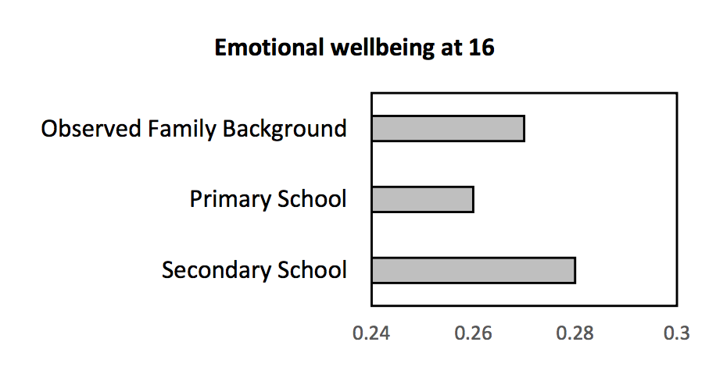
How child emotional wellbeing is affected at 16 by family and schooling

Slide 66
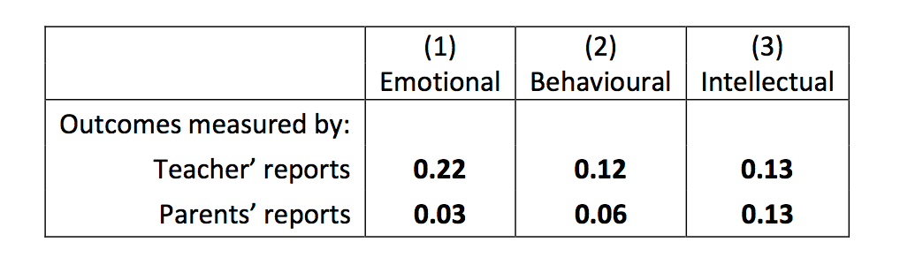
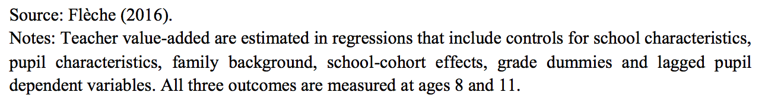
How child outcomes are affected by their teacher (ages 8 and 11)

Slide 67
ALSPAC data: Income and Financial insecurity
Proxy of financial insecurity: mother had a major financial problem (MFP)
“Listed below are a number of events which may have brought changes in your life. Have any of these occurred since your study child’s XXX birthday?”
  You had a major financial problem
Measure of financial insecurity: # years mother reported to have a MFP from child’s birth to age 11
Which matters more: financial insecurity or income?

Slide 68
ALSPAC data: Financial insecurity
Correlation between income and financial insecurity
Corr = -0.14

Slide 69
Summary

Slide 70
ALSPAC data: Arguing and Separation
We found above that both separation and family conflict affect child outcomes.
But do they interact?
For childhood emotional health, we find a monotonic effect of conflict, but a non-monotonic effect of parental separation:
No Arguing, No Separation
No Arguing, Separation
Arguing, Separation
Arguing, No Separation

Slide 71
A Well-being Policy
All of adulthood, childhood and family are correlated with adult life satisfaction: intervention can “work” at all ages.
We are not entirely determined by our family or childhood.
The largest correlations are with adult emotional health and childhood emotional health. Partnership also matters

Slide 72
A Well-being Policy
Childhood emotional health is determined by
Childhood financial insecurity
Family conflict and separation
An enormous role for schools, and for teachers within schools.

Slide 73
A Well-being Policy
We live in societies
What others do affects us:
Both directly in terms of crime;
And indirectly in terms of social comparisons

Slide 74
 | Effect on life-satisfaction (0-10) | Total effect on the life-satisfaction (0-10) of others
Income doubles | +0.12 | -0.12
One extra year of education | +0.03 | -0.09
Unemployed (versus employed) | -0.70 | -2.00
Quality of work (1 SD extra) | +0.40 | --
Partnered (versus single) | +0.59 | +0.68
Separated (versus partnered) | -0.74 | --
Widowed (versus partnered) | -0.48 | --
Being a parent | +0.03 | --
One physical illness | -0.22 | --
Depression or anxiety | -0.72 | --
Commit one crime | -0.30 pt-years | -1.00 pt-year
If we had to choose adult outcomes to raise societal well-being then these would probably be unemployment, partnership and mental health.

Slide 75
… and these are the domains with larger standardised effects on life satisfaction, as we saw from Chapter 1.
How adult life satisfaction at 34 and 42 is explained by adult outcomes
β | s.e.
0.07 | (0.01)
0.02 | (0.01)
0.08 | (0.01)
0.06 | (0.02)
0.17 | (0.01)
0.06 | (0.01)
0.18 | (0.01)

Slide 76
CURRENT WORK
Extension of birth-cohort analysis to other countries
Evaluating policies with well-being as the outcome: identifying RCTs with well-being outcomes, and running our own.
Using the results of naturalistic data analysis and RCTs to set up a microsimulation model of the economy, in well-being rather than income terms (WBUK)

Slide 77


Slide 78
Short Moods and Feelings questionnaire
These questions are about how you may have been feeling or acting recently. For each question, please say how much you have felt or acted this way in the past two weeks.
In the past two weeks: | NOT TRUE | SOMETIMES | TRUE
1. I felt miserable or unhappy. | 2 | 1 | 0
2. I have been having fun.* | 0 | 1 | 2
3. I didn't enjoy anything at all. | 2 | 1 | 0
4. I felt so tired I just sat around and did nothing. | 2 | 1 | 0
5. I was very restless. | 2 | 1 | 0
6. I felt I was no good anymore. | 2 | 1 | 0
7. I cried a lot. | 2 | 1 | 0
8. I felt happy.* | 0 | 1 | 2
9. I found it hard to think properly or concentrate. | 2 | 1 | 0
10. I hated myself. | 2 | 1 | 0
11. I enjoyed doing lots of things.* | 0 | 1 | 2
12. I was a bad person. | 2 | 1 | 0
13. I felt lonely. | 2 | 1 | 0
14. I thought nobody really loved me. | 2 | 1 | 0
15. I thought I could never be as good as other kids. | 2 | 1 | 0
16. I felt I did everything wrong. | 2 | 1 | 0
17. I have had a good time.* | 0 | 1 | 2
Total SMFQ score: 0-26 (0-34 if *included)
* Only in the age 16 questionnaire

Slide 79
Antisocial behaviors (DAWBA)
We're now going to ask about behaviour that sometimes gets children into trouble, including dangerous, aggressive or antisocial behaviour. Please answer according to how s/he has been over the last year.
As far as you know, over the last 12 months... |  | NO |  | PERHAPS |  | DEFINETELY
Has s/he often told lies in order to get things or favours from others, or to get out of having to do things s/he is supposed to do? |  | 0 |  | 1 |  | 2
Has s/he often started fights? (Other than with brothers and sisters) |  | 0 |  | 1 |  | 2
Has s/he often bullied or threatened people? |  | 0 |  | 1 |  | 2
Has s/he often stayed out after dark much later than s/he was supposed to? |  | 0 |  | 1 |  | 2
Has s/he stolen from the house, or from other people's houses, or from shops or school? (This doesn't include very minor thefts, e.g. stealing his/her brother's pencil or food from the fridge) |  | 0 |  | 1 |  | 2
Has s/he run away from home more than once, or ever stayed away all night without your permission? |  | 0 |  | 1 |  | 2
Has s/he often played truant (bunked off) from school? |  | 0 |  | 1 |  | 2
We're now going to ask you about a list of less common but potentially more serious behaviours. We have to ask all people all questions even when they are not likely to apply.
As far as you know, over the last 12 months... | NO |  | YES
Has s/he used a weapon or anything that could seriously hurt someone? (e.g. a bat, brick, broken bottle, knife, gun) | 0 |  | 1
Has s/he really hurt someone or been physically cruel to them? (e.g. has tied up, cut or burned someone) | 0 |  | 1
Has s/he been really cruel on purpose to animals and birds? | 0 |  | 1
Has s/he deliberately started a fire? (This is only if s/he intended to cause severe damage.) | 0 |  | 1
Has s/he deliberately destroyed someone else's property? | 0 |  | 1
Has s/he been involved in stealing on the streets, e.g. snatching a handbag or mugging? | 0 |  | 1
Has s/he broken into a house, any other building or a car? | 0 |  | 1
Has your teenager's ever been in trouble with the police? | 0 |  | 1
Total Antisocial behaviours score: 0-22

Slide 80
Strengths and Difficulties Questionnaire (SDQ)
Please think about this child’s behaviour over the last 6 months if you can:
This child: | NOT TRUE | SOMEWHAT TRUE | CERTAINLY TRUE
Emotional health:
Often complains of headaches, stomachaches or sickness | 0 | 1 | 2
Has many worries, often seems worried | 0 | 1 | 2
Is often unhappy, down-hearted or tearful | 0 | 1 | 2
Is nervous or clingy in new situations, easily loses confidence | 0 | 1 | 2
Has many fears, is easily scared | 0 | 1 | 2
Conduct problems:
Has temper tantrums or hot tempers | 0 | 1 | 2
Is generally obedient, usually does what adults request | 2 | 1 | 0
Often fights with other children or bullies them | 0 | 1 | 2
Often lies or cheats | 0 | 1 | 2
Steals from home/school/elsewhere | 0 | 1 | 2
Hyperactivity/Inattention:
Is restless, overactive, cannot stay still for long | 0 | 1 | 2
Constantly fidgets or squirms | 0 | 1 | 2
Is easily distracted, concentration wandered | 0 | 1 | 2
Thinks things out before acting | 2 | 1 | 0
Sees tasks through to the end, good attention span | 2 | 1 | 0
Peer relationship problems:
Is rather solitary, tends to play alone | 0 | 1 | 2
Has at least one good friend | 2 | 1 | 0
Is generally liked by other children | 2 | 1 | 0
Is picked on or bullied by other children | 0 | 1 | 2
Gets on better with adults than with other children | 0 | 1 | 2
Total Difficulties score (“Behavioural score”) = emotional + conduct + hyperactivity + peer relationship scores (0-40)

