Slide 1
Stumbling into the Gap
Stagnation, Labor, Investment and Productivity in Europe
Bart van Ark, 23 January 2014

Slide 2
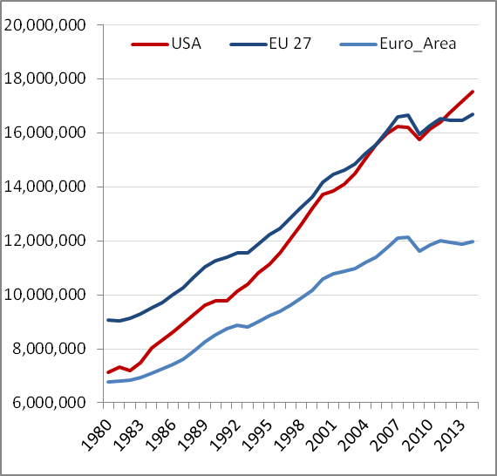
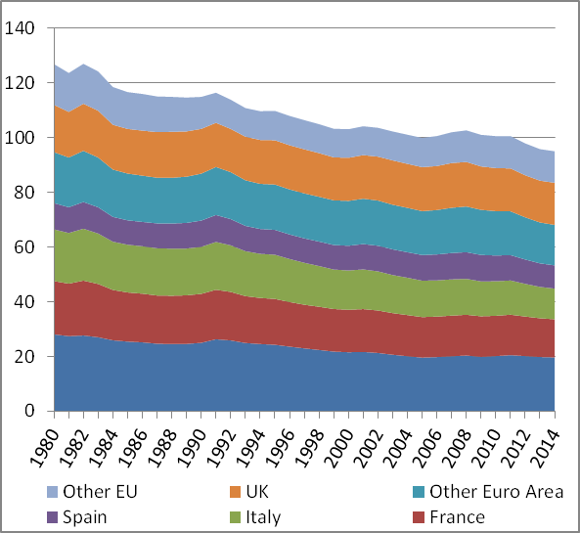
US have overtaken EU GDP level in aftermath of the crisis – with biggest decline in Italy
Level of GDP, PPP-converted, rebased to 2014 $
Share of GDP relative to US=100
US=100
Other EU
Euro Area
UK
Other Euro
Spain
Italy
France
Germany
Source: The Conference Board Total Economy Database^{TR}

Slide 3
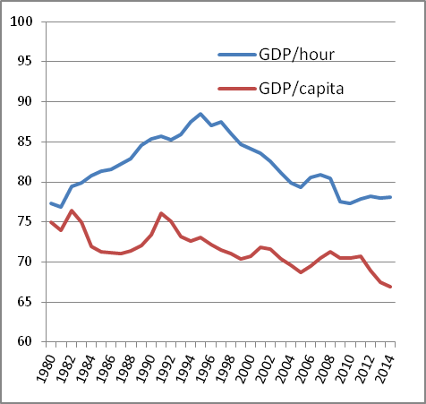
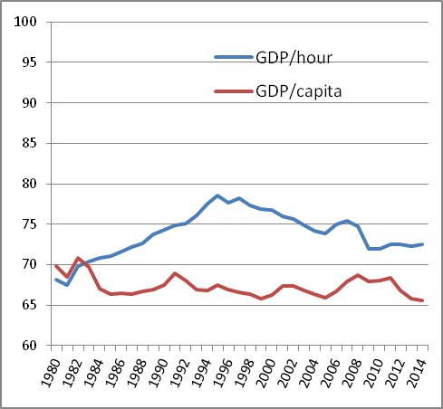
While opening up of EU-US productivity gap stabilized since the crisis, the per capita income gap widened
Level of per capita income and labor productivity relative to USA=100 rebased to 2014 $
Euro Area European Union
Source: The Conference Board Total Economy Database^{TR}

Slide 4
Secular stagnation? What secular stagnation?
The emergence of low (or negative) real interest rates, low inflation and weakened potential output growth are the key ingredients of the secular stagnation hypothesis.
Demand side: “Macroeconomic policy will have difficulty to achieve full employment and production at potential, and if these goals are attained there is likely to be a price paid in terms of financial stability.”
Supply side: “The gap of actual performance below potential is quite narrow and slow growth is more a problem of slow potential than a remaining gap. The growth slowdown is structural related to demographics, education, inequality and government debt.”
Source: C. Teulings and R. Baldwin, Secular Stagnation: Facts, Causes and Cure, VoxEU, 2014

Slide 5
What gaps?
Output gaps
relative to potential
Employment gaps:
relative to NAI(W)RU
relative to total or working age population
comparative levels of participation
Productivity gaps:
relative to other economies (in levels or growth rate)
TFP or labour productivity?
Investment gaps
relative to full capacity
relative to “optimal” rate (DIW)
level of capital deepening
tangible vs. intangible investment
Also: demand gap, skill gap, income gap, profitability gap (not covered here)

Slide 6
The Output Gap

Slide 7
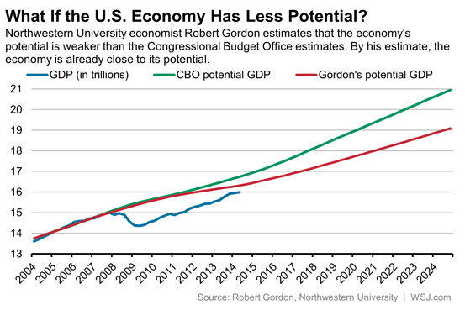
Alternative measures of potential GDP levels suggest U.S. economy to reach full capacity in next two years
2%
2%
Source: Chart obtained from WSJ, sourced from Robert J. Gordon, A New Method of Estimating Potential Real GDP Growth. Implications for the Labor Market and the Debt/GDP Ratio, NBER, Working Paper 20243, August 2014

Slide 8
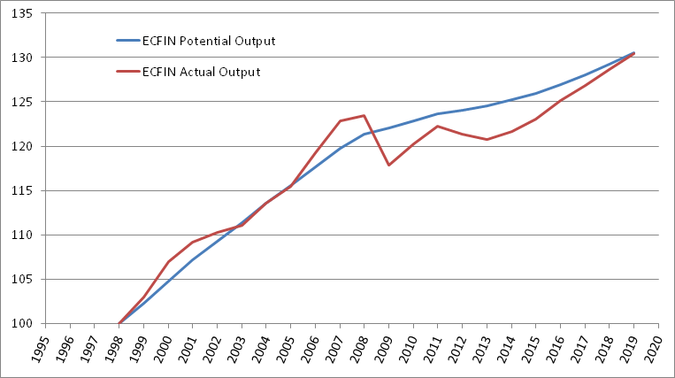
In Euro Area the output gap is expected to not close before the end of the decade
Source: DG ECFIN

Slide 9
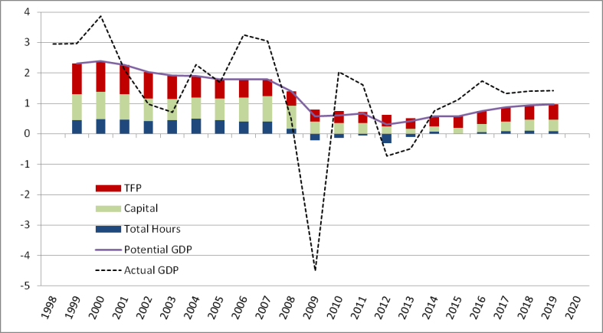
Weak recovery of potential largely due to employment and investment – will productivity recover?
Source: DG ECFIN

Slide 10
Output gap measures are problematic and highly sensitive to assumptions
Potential output growth represents the level of output an economy can produce in a noninflationary way, given the size of its labor force and its potential to invest in and create technological progress
Capital stock focus on structural determinants of capital stock which are considered the sustainable component of capital
Labour which is based on NAWRU is sensitive to actual unemployment rate
Total factor productivity smoothing with HP filter replaced by Kalman filters which are less sensitive .
Source: Zsolt Darvas, Mind the Gap ! And the way structural budget balances are calculated – An alternative calculation of the output gap, Bruegel, on-line, 12 October 2013

Slide 11
TCB growth projections are based on measurement of trend growth rather than potential output growth
Projections of Gross Domestic Product (GDP) for medium- (2015-2019) and long-term (2020-2025) trend growth cover 11 regions, including 33 advanced economies and 22 major emerging economies
Model uses a supply side-based growth accounting framework which measures supply side contributions of labor, capital and productivity.
Labor is projected by demographic information (UN population and ILO labor force participation)
Capital services growth and total factor productivity growth are estimates by regression approach using relevant variables
Results from the model represent trend growth which measures growth based on historical relationships between variables, as measured in the model.
We adjust 2015-2019 and 2015 itself for short-term deviations from the trend growth because of assumed output gaps in 2014
Source: Abdul A. Erumban and Klaas de Vries, Projecting Global Economic Growth The Conference Board Global Economic Outlook 2015, Economic Program Working Paper #14-03, The Conference Board

Slide 12
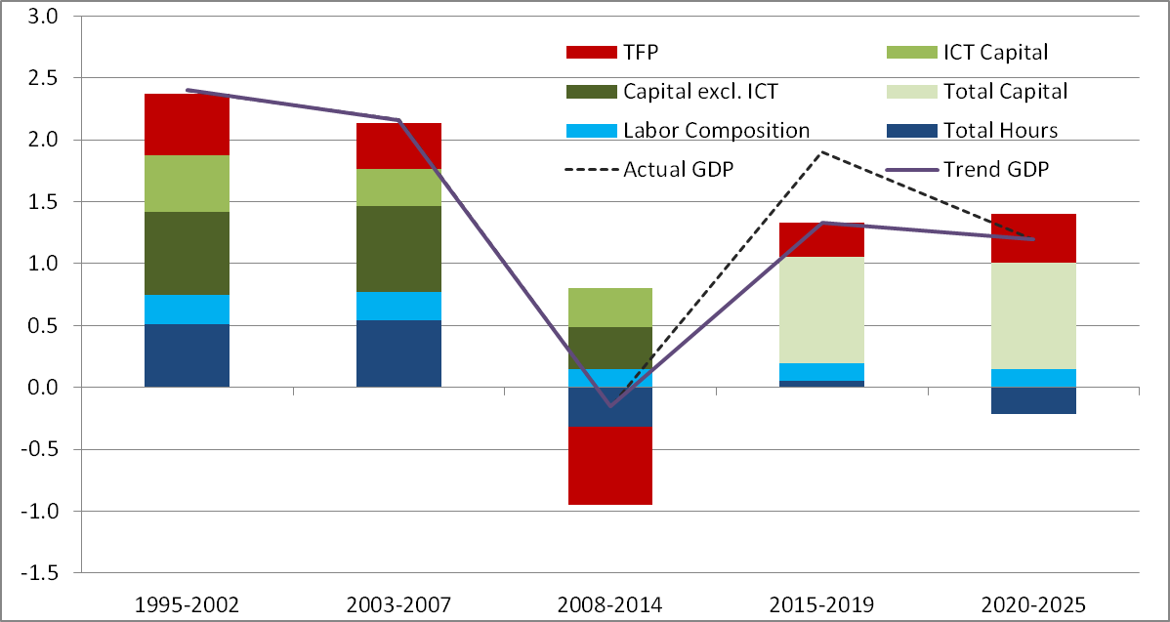
Weak demographics and slow productivity growth raises major threat to long-term growth prospects
Growth contributions of labor, capital and productivity in Euro Area, % contributions
January adjustment over November
Source: The Conference Board Global Economic Outlook 2015, November 2014 (https://www.conference-board.org/data/globaloutlook.cfm)

Slide 13
The Employment Gap

Slide 14
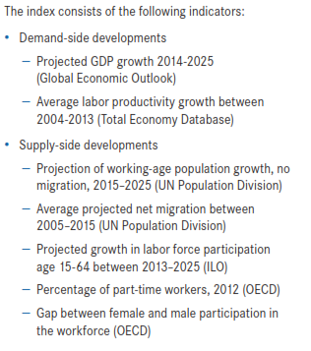
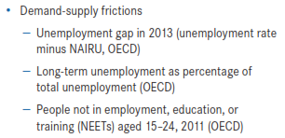
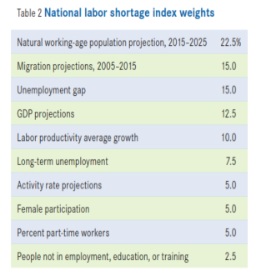
A new labour shortages index
Source: The Conference Board

Slide 15
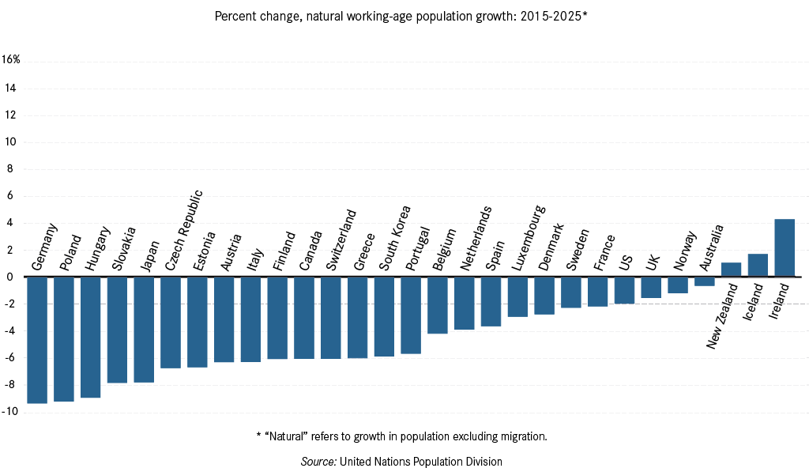
Most mature economies are projected to have negative natural working-age population growth over the next decade.
Phase 1
Notes:
Chart 8

Slide 16
International comparative labour shortages index shows wide variation in shortages
Source: The Conference Board
Note: The index is created by normalizing the components so that the weight of the impact of different indicators is similar.

Slide 17
The Productivity Gap

Slide 18
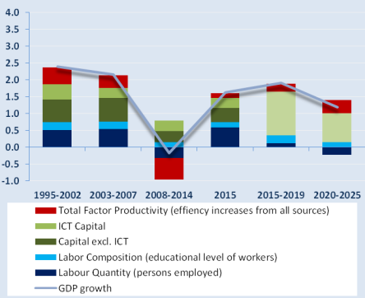
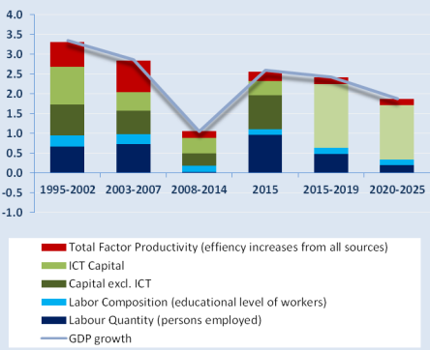
Europe is not alone in facing a major productivity challenge
Growth contributions to GDP growth (%)
Euro Area United States
Source: The Conference Board Global Economic Outlook 2015, November 2014 (https://www.conference-board.org/data/globaloutlook.cfm)

Slide 19
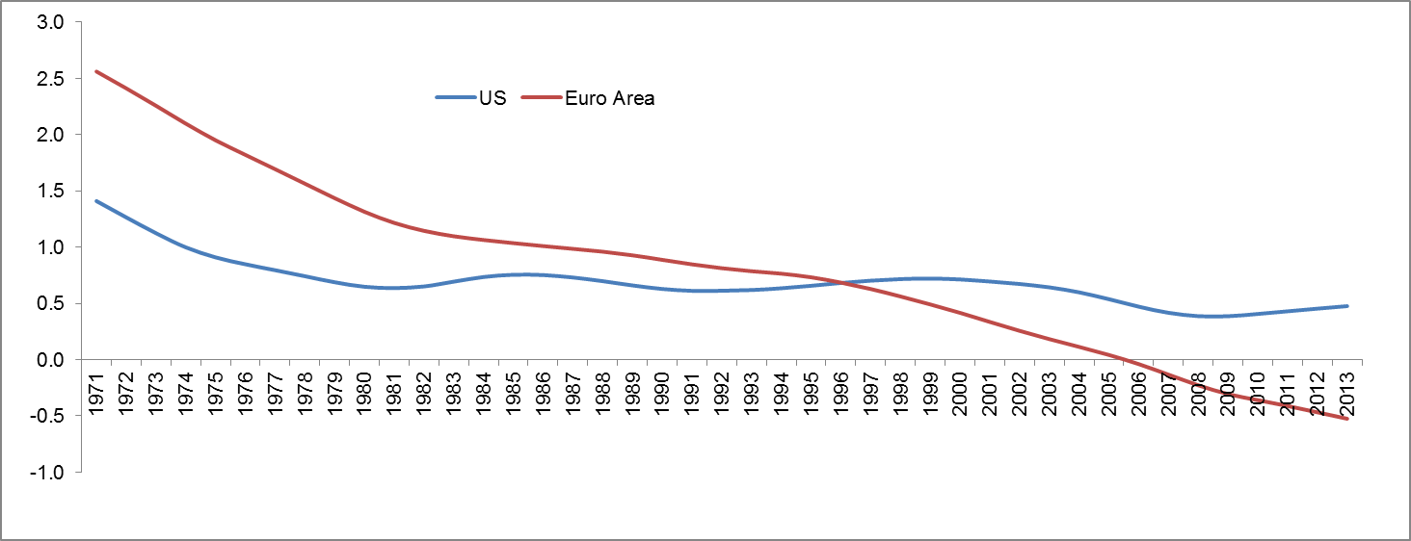
Negative TFP growth is not sustainable in the long term
Trend growth of total factor productivity using HP filter
Note: Total factor productivity growth accounts for the changes in output not caused by changes in labor or capital inputs.
Source: The Conference Board Total Economy Database

Slide 20
How can negative total factor productivity growth happen and can it last for long?
Negative effects from recession should be short-lived once the economy recovers
Increased rigidities in labor, product and capital markets lead to greater misallocation to less productive firms
Negative reallocation effects with more resources going to less productive sectors in the economy (EU KLEMS)
Caveat: TFP is a residual, so measurement error in output or inputs and unmeasured effects end up here
Longer-term, TFP signals weaker technological progress and innovation – an ongoing trend since decades

Slide 21
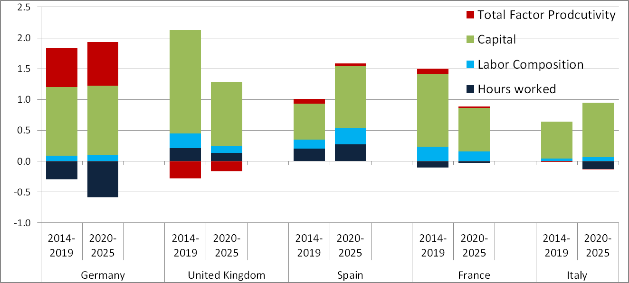
Offsetting effects between productivity growth and demographics are challenging across Europe
Sources of GDP Growth, average annual contribution % change
Source: The Conference Board Total Economy Database & Global Economic Outlook 2014, Update May 2014 (https://www.conference-board.org/data/globaloutlook.cfm)

Slide 22
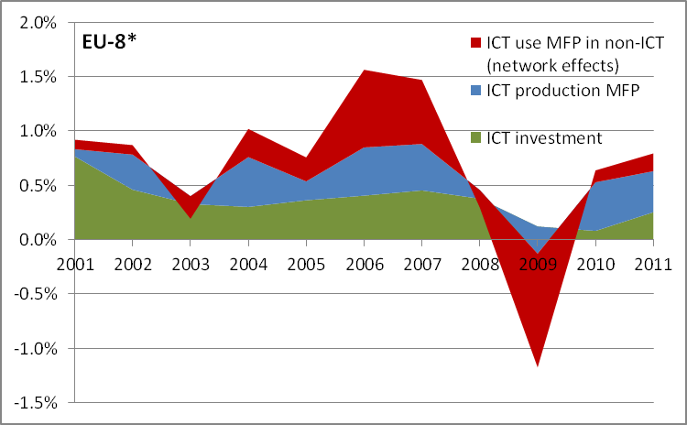
ICT was good for about 1 %-point of EU GDP growth before crisis; since then 10 times less as ICT use effects in non-ICT sector collapsed and slowly recover
Growth Contributions from ICT Production, Investment and Use in Non-ICT sector, 2001-2011
* EU-8 includes Austria, Finland, France, Germany, Italy, Netherlands, Spain and the United Kingdom
Source: Bart van Ark, Productivity and Digitalisation in Europe. Paving the Road to Faster Growth, Lisbon Council/The Conference Board, May 2014.

Slide 23
What Investment Gaps?

Slide 24
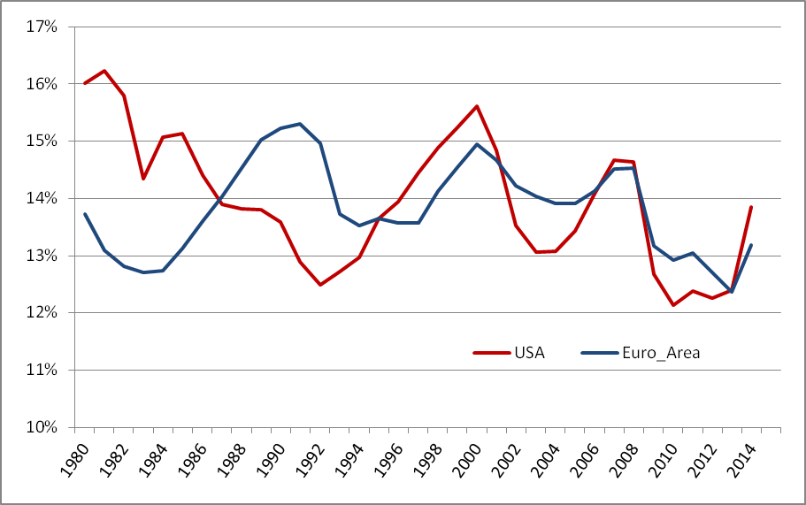
Investment-output ratios show cyclicality but long-term trend is down
Investment-output ratios, excluding residential, in current prices
Source: The Conference Board Total Economy Database^{TR}

Slide 25
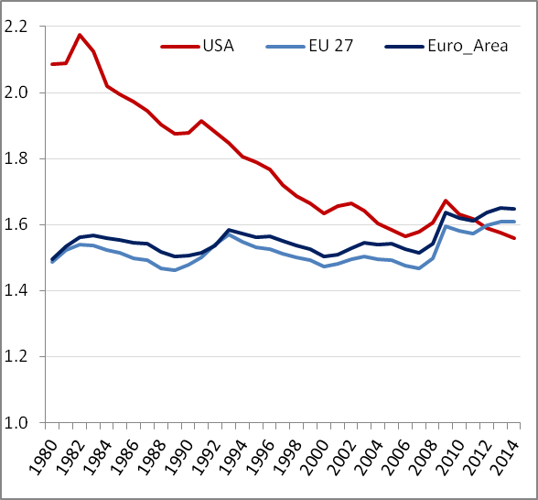
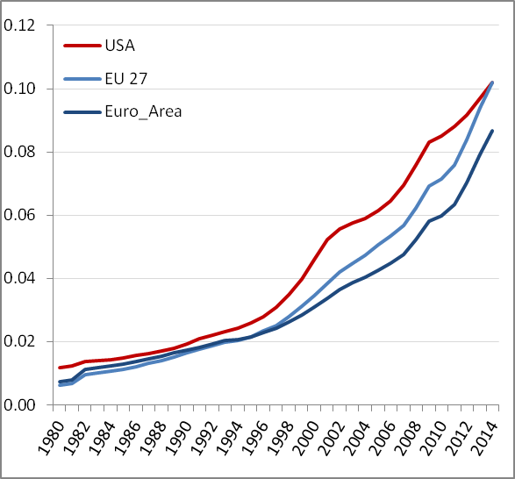
Capital-output ratios in non-ICT in U.S. have fallen behind Euro Area, but Euro Area rapidly caught up on ICT
Level of capital stock per unit of output, in 2014 US$ (PPP-converted)
Non-ICT capital-output ratios ICT capital-output ratios
Source: The Conference Board Total Economy Database^{TR}

Slide 26
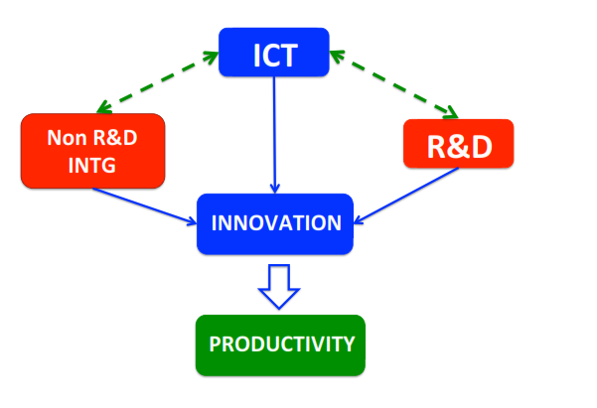
Why is it important to take a perspective on technology and innovation beyond ICT, including intangibles?
Source: Corrado, Haskel, Jona-Lasinio and Iommi, (2014)

Slide 27
An extended framework for investment in intangibles is needed to understand impact of technology on growth
Broad category Type of Investment
Computerized Information
Software
Databases
Innovative Property
R&D
Mineral exploration
Entertainment and artistic originals
Design and other new product development costs
Economic Competencies
Branding (market research and long-lived advertising)
Firm-specific human capital (training)
Organizational capital (business process investment)

Slide 28
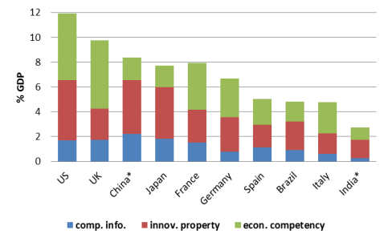
Intangible capital will gradually overtake tangible capital, fundamentally changing our perspective on growth
Investment in Market Sector GDP in 2008, as % of GDP
Investment in Private Industries in the United States, 1977-2011, as ratio to GDP
Note: Intangible investment in China and India are for the total economy, while investment in the rest of the countries are for the market sector.
Sources: Corrado et. al. (2012), except for Chinaf rom Hulten and Hao (2012), India from Hulten, Hao and Jaeger (2012), Brazil from Dutz et. al. (2012), and Japan from RIETI.

Slide 29
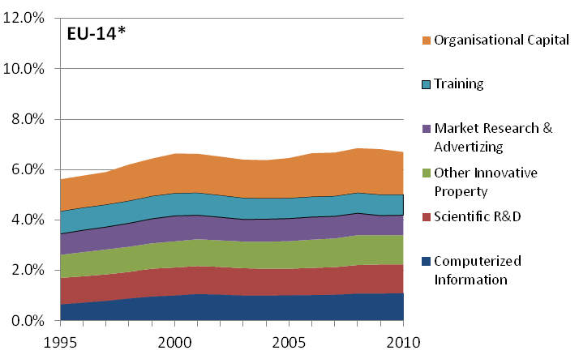
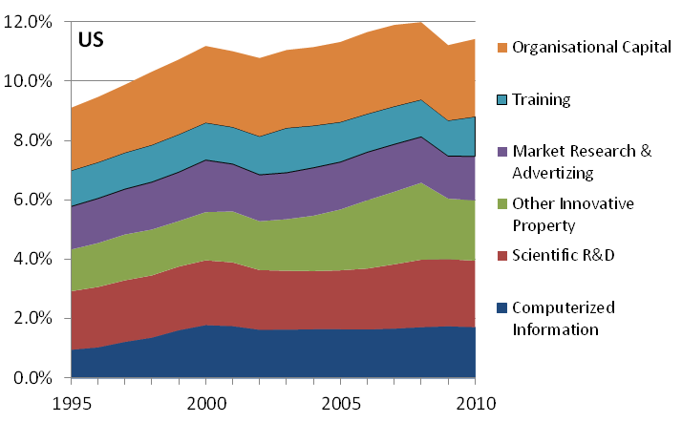
The largest gaps in capital-output ratios between EU and US are in intangible assets
Investment intensity of intangible assets as a % of GDP for 14 EU economies
and the US (1995-2010)
EU-14 refers to the EU-15 before 2004, excluding Sweden and Denmark, but including Slovenia

Slide 30
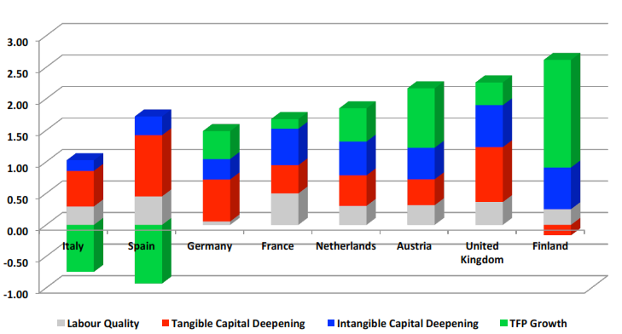
In several cases the role of intangible capital contribution to labor productivity growth is beginning to outpace tangibles
Contributions to labour productivity growth, 1995-2009
Source: Corrado, Haskel, Jona-Lasinio and Iommi, (2014)

Slide 31
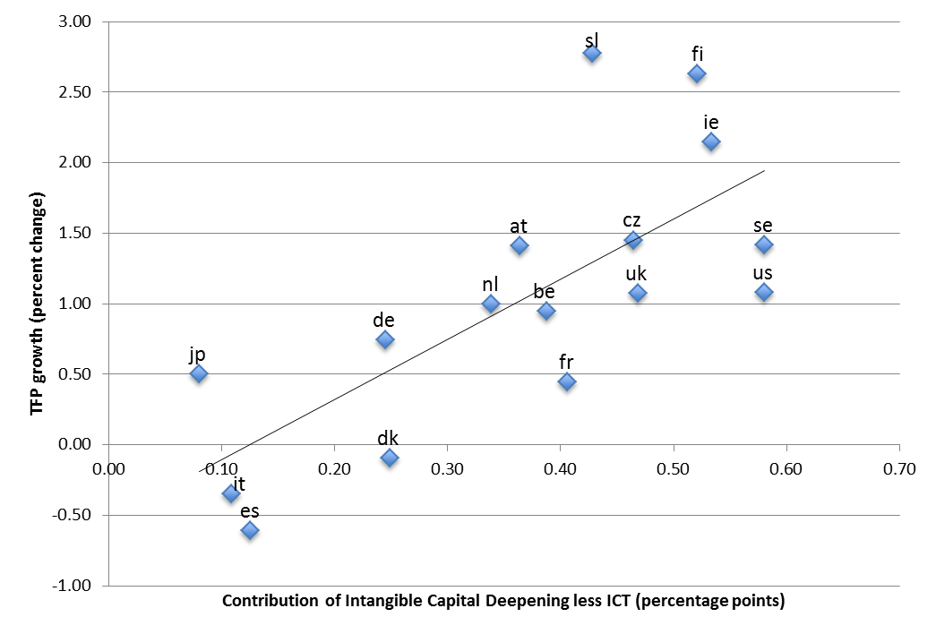
The non-rival nature of intangibles implies a theoretical link from investment to productivity growth via diffusion
Source: Corrado, Haskel, Jona-Lasinio, and Iommi (2013); www.INTAN.Invest.net

Slide 32
From “Stumbling into the Gap” to “Jumping over the Gap”

Slide 33
Management of labor shortages, strengthening productivity and investment in intangible capital defines policy priorities
Europe’s erosion in global economic leadership is mainly driven by labor market challenges and productivity growth
Labor market shortages are likely to accelerate as unemployment rates gradually drop and working age population declines.
Human capital should be key focus to manage skill gaps
Investment-output ratios show cyclicality but slowing long-term trend in both U.S. and Europe
While non-ICT capital-output ratios dropped in U.S., ICT capital in Euro Area has caught up rapidly with U.S.
A greater focus on intangible capital might help improve the connection between investment and productivity

Slide 34
Appendix

Slide 35
Improved model on estimating productivity and capital services
independent variables | TFPG | Saving | Capital Services | Description
TFPG_t1 | + |  |  | Total factor productivity growth in the previous period
log_LPUS_t1 | - |  |  | Relative level of labor productivity in the previous period
CORUPT | - |  |  | Corruption
rRDgrowth | + |  |  | Growth rate of real R&D spending
HDI | + |  |  | Geometric average of average years of schooling and life expectancy
DEP_ALL |  | - |  | Old and young dependency ratios
SERVICE |  | - |  | Service share in GDP
log_PERCAP_GDP |  | + |  | Log of per capita GDP
GDP_GROWTH_t1 |  | + | + | GDP growth in the previous period
TFPG |  |  | +/- | Total factor productivity growth
SAVING |  |  | + | Saving rate
DPN_RATE |  |  | + | Depreciation rate
Z_INFLATION |  |  | - | Standard deviation of inflation
WAGEgrowth |  |  | + | Growth rate of wages
ENERGYgrowth |  |  | + | Growth rate of energy use
log_K_DEEP_t1 |  |  | - | Log of capital deepening in the previous period
Region Dummies | +/- | +/- | +/- | Region dummies
Notes:
total economy database (TED) for pre-2014 years
Labor is projected by demographic information (labor force projections, projections of educational composition of population)
Capital and total factor productivity are estimated econometrically using a set of chosen explanatory factors and a system of equation with 3SLS
These three equations are estimated simultaneously using 3 SLS to ensure consistent and efficient estimation
Some of the endogenous variables are also explanatory variables in other models
capital is influenced by TFP, which is an endogenous variable, hence making instrumental variable estimation needed
generalized least squares should be used to account for the correlation among the error terms across equations.
TFP: variables related to Innovation and absorption
Saving rate is not part of the growth accounting, but why is it still in the model
Saving rate is closely related to investment, which is an important determinant of growth of capital services
Taking elements of demand side in our supply side model

Slide 36
Significant influence from a variety of factors on growth
 | TFPG |  | SAVING |  | CAPSERV
TFPG_t1 | 0.14 | ***
log_LPUS_t1 | -1.25 | ***
CORUPT | -0.31 | **
rRDgrowth | 0.05 | ***
HDI | 1.24 | **
DEP_ALL |  |  | -0.22 | ***
SERVICE |  |  | -0.34 | ***
log_PERCAP_GDP |  |  | 8.35 | ***
GDP_GROWTH_t1 |  |  | 0.52 | *** | 0.21 | ***
TFPG |  |  |  |  | -0.35 | ***
SAVING |  |  |  |  | 0.03 | **
DPN_RATE |  |  |  |  | 0.60 | ***
Z_INFLATION |  |  |  |  | -0.36 | **
WAGEgrowth |  |  |  |  | 0.30 | ***
ENERGYgrowth |  |  |  |  | 0.30 | ***
log_K_DEEP_t1 |  |  |  |  | -0.74 | ***
Region Dummies | yes |  | yes |  | yes
_cons | -4.10 | ** | 53.86 | *** | -0.14
N | 271
* significant at 10%; ** significant at 5%; *** significant at 1%

