Slide 1
The Spanish Productivity Puzzle
Laura Hospido
Eva Moreno Galbis
CEPREMAP Productivity Project
23rd January 2015 Conference
The opinions and analyses are the responsibility of the authors and, therefore, do not necessarily coincide with those of the Banco de España or the Eurosystem

Slide 2
Motivation
The divergent experiences in the US and in Europe have increased the interest in understanding productivity growth.
Source: OECD Statistics
Figure 1: Labor productivity growth

Slide 3
What we do
At the macro level we present facts on the potential determinants of labor productivity.
At the micro level:
  We estimate TFP between 1995-2012
  We estimate TFP at the micro level and aggregate then to analyze potential composition effects
  We focus on the relationship between TFP and several factors:
    Labor force composition, collective agreements
    Use of foreign markets

Slide 4
1. Macro evidence

Slide 5
1.GDP per capita
From a strict accountability point of view, Y/P=L/P·Y/L where Y is GDP, L employment, and P total population.
Source: OECD Statistics
Figure 2: Labor productivity, GDP per capita and employment over total population in Spain (annual rates of growth, %)

Slide 6
1.1 Labor market performance
Source: OECD Statistics
Figure 3: Employment rates in Spain, France, Germany, UK and EU-27
Source: OECD Statistics
Source: OECD Statistics
Figure 4: Share of temporary workers (panel A) and part-time workers (panel B)

Slide 7
1.1.a. Factors influencing labor market performance
Labor Costs: Wages in the private sector only started to exhibit negative growth rates in real terms since 2010
Employment protection: not major divergences in employment protection legislation between Spain and other European countries
Hours of work: Stable between 2008-2012

Slide 8
1.1.a. Factors influencing labor market performance
Collective agreement system:
  Principle of statutory extension: any minimum conditions established in a collective agreement at higher than firm level apply to every worker forming part of the corresponding geographical and/or industry unit.
  Principle of ultra-activity: any agreement remains valid after its expiry, if it has not been renewed.
These two principles make very difficult for a firm to easily adjust to adverse economic conditions=> Reforms 2009, 2010, 2012

Slide 9
1.1.a. Factors influencing labor market performance
Demographic composition:
Source: OECD statistics
Source: INE
Figure 5: Inflows of foreign population ( in thousand) (panel A) and population composition by age , % (panel B)

Slide 10
1.2 Sector composition
Source: INE
Source: INE
Figure 6: Contribution in % to total employment of the construction sector
Figure 7: Contribution in % of each branch
to industrial employment

Slide 11
1.3 Access to credit
Source: Eurostat
Figure 8: Success rate in obtaining loan finance by sources. Total business economy except financial and insurance activities. Percentage of requests accepted.
Source: INE
Figure 9: R&D expenditures in %GDP

Slide 12
1.4 The use of foreign markets
Firms have the possibility to circumvent an economic crisis by exporting towards countries less affected by the recession or importing from cheaper suppliers abroad.
The balance of payment of the Spanish economy considerably improved during the crisis due to the relative increase in exports.
  => competitiveness gains seem to be largely explained by the reduction in unitary labor costs, rather than by an improvement in the efficiency of production methods => competitiveness gains have been unable to create employment

Slide 13
2. Micro evidence

Slide 14
2.1 Data sources
Our dataset combines information from several data sources:
Bank of Spain's Central Balance Sheet and the Mercantile Registries: data on the number of employees by type of contract, business name, location, several balance sheet items, profit and loss account items, standard financial ratios, and sector of activity at the 4-digit level
Collective Agreement Registries: data on the level of the collective agreements.
Balance of Payment Registries: data on imports/exports

Slide 15
2.1.a Sample selection
Central Balance Sheet and Mercantile Registries: we have dropped firms with missing or non-positive values for the number of employees, value added, intermediate inputs, physical capital, sector of activity, and year of firm creation.
Collective Agreement Registries:
  Firms with “No Agreement”
  The sample of firms with agreements at the firm level was merged with (A) using the Identifying Fiscal Code of the firm, the name of the firm or the name of the agreement.
  The sample of firms with agreements at the sectoral level is merged to (A) using an indicator of the sector of activity plus the corresponding geographical location.
C) Balance of Payments: add information on exports and
imports.
D) We keep 95% of the observations. We have an unbalanced panel of 5,627,593 obs for the period 1995-2012.

Slide 16
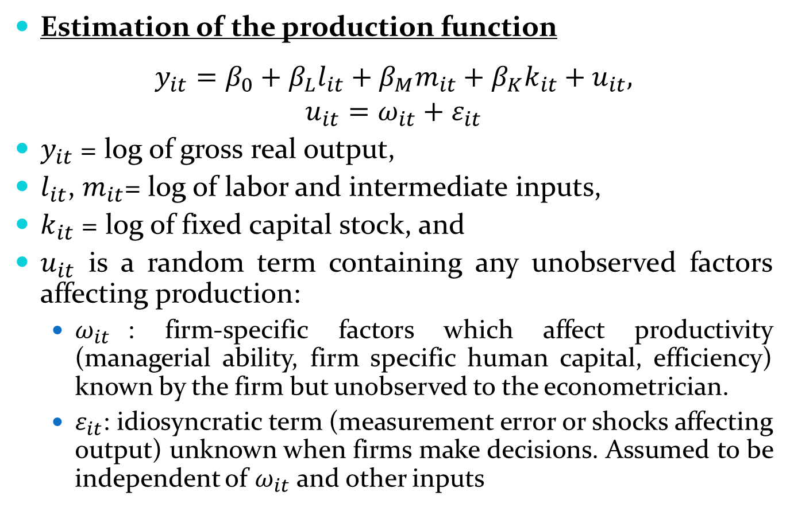
2.2 Measuring TFP
Estimation of the production function
$$y_{it}=β_{0}+β_{L}l_{it}+β_{M}m_{it}+β_{K}k_{it}+u_{it},$$
$$u_{it}=ω_{it}+ε_{it}$$
$y_{it}$ = log of gross real output,
$l_{it}$, $m_{it}$= log of labor and intermediate inputs,
$k_{it}$ = log of fixed capital stock, and
$u_{it}$ is a random term containing any unobserved factors affecting production:
  $ω_{it}$: firm-specific factors which affect productivity (managerial ability, firm specific human capital, efficiency) known by the firm but unobserved to the econometrician.
  $ε_{it}$: idiosyncratic term (measurement error or shocks affecting output) unknown when firms make decisions. Assumed to be independent of $ω_{it}$and other inputs

Slide 17
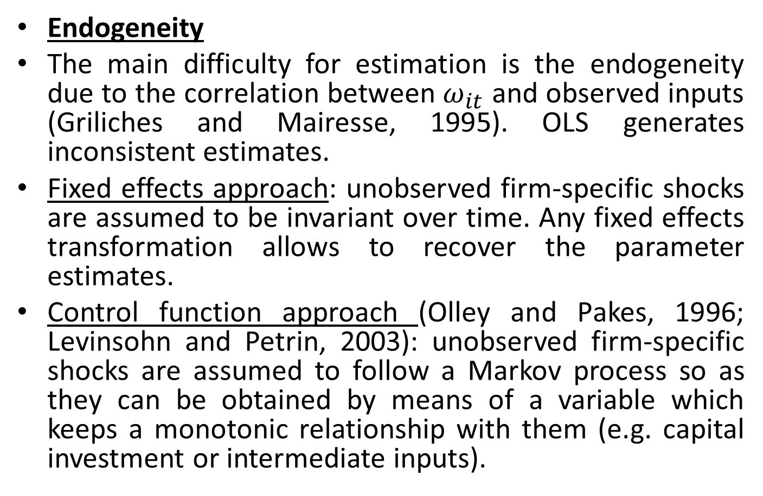
2.2 Measuring TFP
Endogeneity
The main difficulty for estimation is the endogeneity due to the correlation between $ω_{it}$ and observed inputs (Griliches and Mairesse, 1995). OLS generates inconsistent estimates.
Fixed effects approach: unobserved firm-specific shocks are assumed to be invariant over time. Any fixed effects transformation allows to recover the parameter estimates.
Control function approach (Olley and Pakes, 1996; Levinsohn and Petrin, 2003): unobserved firm-specific shocks are assumed to follow a Markov process so as they can be obtained by means of a variable which keeps a monotonic relationship with them (e.g. capital investment or intermediate inputs).

Slide 18
2.2.a Estimation results
 | OLS |  | FE |  | LP
 | βL | βK | βL | Βk | βL | βK
Agriculture | 0,704 | 0,168 | 0,368 | 0,161 | 0,551 | 0,065
 | (0,004) | (0,003) | (0,004) | (0,003) | (0,004) | (0,007)
Extractive | 0,804 | 0,224 | 0,647 | 0,187 | 0,586 | 0,142
 | (0,015) | (0,009) | (0,012) | (0,008) | (0,018) | (0,020)
Manufacture | 0,871 | 0,16 | 0,639 | 0,134 | 0,682 | 0,063
 | (0,002) | (0,001) | (0,001) | (0,001) | (0,002) | (0,002)
Energy | 0,751 | 0,232 | 0,532 | 0,158 | 0,566 | 0,106
 | (0,009) | (0,006) | (0,009) | (0,006) | (0,011) | (0,014)
Construction | 0,784 | 0,156 | 0,68 | 0,093 | 0,591 | 0,106
 | (0,002) | (0,001) | (0,001) | (0,001) | (0,002) | (0,001)
Sales | 0,85 | 0,149 | 0,562 | 0,114 | 0,645 | 0,075
 | (0,001) | (0,001) | (0,001) | (0,001) | (0,002) | (0,001)
Transport | 0,842 | 0,182 | 0,588 | 0,167 | 0,67 | 0,094
 | (0,003) | (0,002) | (0,002) | (0,001) | (0,004) | (0,003)
Tourism | 0,857 | 0,138 | 0,483 | 0,106 | 0,466 | 0,084
 | (0,002) | (0,001) | (0,002) | (0,001) | (0,003) | (0,002)
Education-Health | 0,765 | 0,142 | 0,517 | 0,095 | 0,57 | 0,077
 | (0,004) | (0,002) | (0,003) | (0,001) | (0,004) | (0,004)
Non financial | 0,773 | 0,16 | 0,552 | 0,094 | 0,614 | 0,081
 | (0,001) | (0,001) | (0,001) | (0,001) | (0,002) | (0,002)
Notes: Observations=5,627,593. Bootstrap standard errors in parentheses (100 replications).

Slide 19
2.2.a Estimation results
 | 1995-2007 |  | 2008-2012
 | βL | βK | βL | βK
Agriculture | 0,535 | 0,102 | 0,574 | 0,041
 | (0,006) | (0,011) | (0,006) | (0,011)
Extractive | 0,557 | 0,127 | 0,614 | 0,064
 | (0,023) | (0,016) | (0,023) | (0,039)
Manufacture | 0,665 | 0,058 | 0,707 | 0,058
 | (0,003) | (0,002) | (0,003) | (0,003)
Energy | 0,58 | 0,084 | 0,543 | 0,129
 | (0,011) | (0,015) | (0,016) | (0,024)
Construction | 0,556 | 0,087 | 0,611 | 0,059
 | (0,002) | (0,002) | (0,002) | (0,003)
Sales | 0,632 | 0,08 | 0,664 | 0,063
 | (0,002) | (0,001) | (0,002) | (0,003)
Transport | 0,636 | 0,097 | 0,736 | 0,063
 | (0,003) | (0,004) | (0,005) | (0,007)
Tourism | 0,438 | 0,078 | 0,49 | 0,084
 | (0,004) | (0,003) | (0,005) | (0,005)
Education-Health | 0,553 | 0,083 | 0,595 | 0,075
 | (0,005) | (0,004) | (0,005) | (0,006)
Non financial | 0,597 | 0,104 | 0,637 | 0,063
 | (0,002) | (0,002) | (0,002) | (0,002)
Notes: Observations=3,519,864 for 1995-2007 and 2,098,140 for 2008-2012. Bootstrap standard errors in parentheses (100 replications).

Slide 20
2.2.a Estimation results
 | βLp | βLt | βK
Agriculture | 0,136 | 0,113 | 0,089
 | (0,002) | (0,001) | (0,008)
Extractive | 0,155 | 0,06 | 0,172
 | (0,011) | (0,004) | (0,021)
Manufacture | 0,276 | 0,072 | 0,094
 | (0,002) | (0,000) | (0,002)
Energy | 0,218 | 0,089 | 0,132
 | (0,007) | (0,002) | (0,013)
Construction | 0,141 | 0,106 | 0,145
 | (0,001) | (0,001) | (0,002)
Sales | 0,266 | 0,069 | 0,099
 | (0,001) | (0,000) | (0,001)
Transport | 0,225 | 0,078 | 0,139
 | (0,002) | (0,001) | (0,003)
Tourism | 0,116 | 0,047 | 0,114
 | (0,001) | (0,001) | (0,003)
Education-Health | 0,222 | 0,086 | 0,092
 | (0,002) | (0,001) | (0,004)
Non financial | 0,268 | 0,093 | 0,095
 | (0,001) | (0,000) | (0,001)
Notes: Observations=5,627,593. Bootstrap standard errors in parentheses (100 replications).

Slide 21
2.2.b The evolution of TFP
$${\hat{TFP}}_{it}≡\exp\left({\hat{ω}}_{it}\right)=exp(v_{it}−{\hat{β}}_{0}−{\hat{β}}_{L}l_{it}−{\hat{β}}_{K}k_{it})$$
Figure 11: Aggregate TFP growth (employment shares)
Figure 10: Firms’ TFP growth

Slide 22
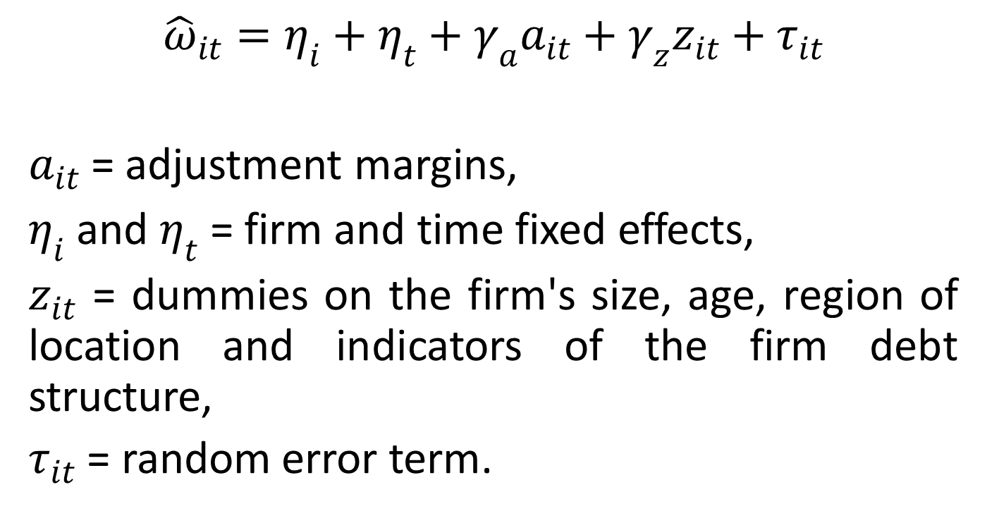
2.3 Margins of adjustment used by the firms
$${\hat{ω}}_{it}=η_{i}+η_{t}+γ_{a}a_{it}+γ_{z}z_{it}+τ_{it}$$
$a_{it}$= adjustment margins,
$η_{i}$ and $η_{t}$ = firm and time fixed effects,
$z_{it}$ = dummies on the firm's size, age, region of location and indicators of the firm debt structure,
$τ_{it}$ = random error term.

Slide 23
2.3.a Firm fixed effects regression
 | [1] | [2] | [3] | [4]
Share of Lt | -0.051*** | -0.037*** | -0.037*** | -0.037***
 | (0.001) | (0.002) | (0.002) | (0.002)
Importer-exporter | 0.086*** | 0.060*** | 0.063***
 | (0.001) | (0.002) | (0.002)
Importer-exporter-2008 threshold |  |  |  | 0.091***
 |  |  |  | (0.002)
Firm agreement | 0.122*** | 0.075*** | 0.076*** | 0.076***
 | (0.017) | (0.020) | (0.020) | (0.020)
Province agreement | -0.025*** | -0.019*** | -0.019*** | -0.019***
 | (0.002) | (0.003) | (0.003) | (0.003)
Regional agreement | -0.027*** | -0.034*** | -0.033*** | -0.032***
 | (0.003) | (0.004) | (0.004) | (0.004)
National agreement | -0.007*** | -0.004 | -0.003 | -0.003
 | (0.002) | (0.003) | (0.003) | (0.003)
Debt ratio |  |  | -0.046*** | -0.046***
 |  |  | (0.001) | (0.000)
Short term ratio |  |  | -0.005*** | -0.005***
 |  |  | (0.000) | (0.000)
Constant | 3.292*** | 3.256*** | 3.258*** | 3.263***
 | (0.096) | (0.107) | (0.109) | (0.108)
Observations | 5,618,004 | 2,862,843 | 2,862,843 | 2,862,843
R-squared | 0.041 | 0.045 | 0.051 | 0.051
Number of id | 962,232 | 735,297 | 735,297 | 735,297
Robust standard errors in parentheses. Controls: Size and age of the firm. Year, region and sector dummies included.
*** p<0.01, ** p<0.05, * p<0.1

Slide 24
2.3.b Time variation of the adjustment margins
Figure 12: Time variation of the adjustment margins

Slide 25
2.3.b Time variation: Temporary employment rates
Figure 13: Temporary employment rates and skill composition

Slide 26
2.3.b Time variation : robustness check
Figure 14: Whole sample vs. balanced sample: time variation of adjustment margins

Slide 27
Take away
Explanation of the two puzzles:
  Explanations for the slowdown: proliferation of temporary contracts and prevalence of low productive activities as construction, sales, retail trade, hotels and catering.
  Explanations for the increase during the Great Recession: massive job destruction (selection of temporary workers). Importer-exporter firms and firms committed to a collective agreement at the firm level display a better behavior.
  => The "Spanish productivity puzzle" does not respond to permanent factors and results rather from massive job destruction and an increased weight of large firms displaying better TFP performance. Average total factor productivity has been deteriorated during the crisis period.

