Slide 1
Productivity Puzzles in Europe
Paris, January 2015

Slide 2
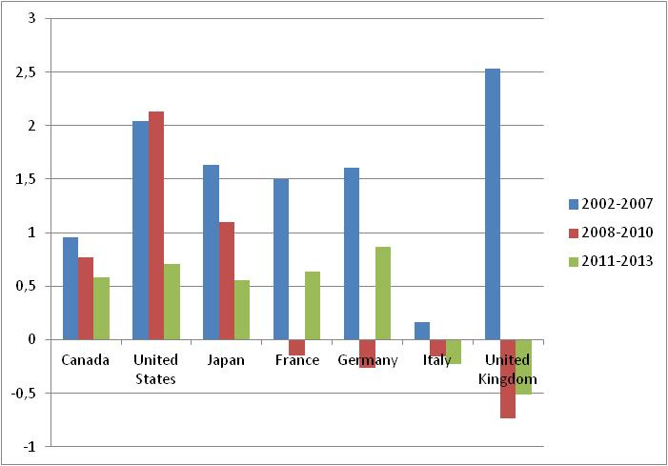
G7: Annual hourly productivity growth % (Source: OECD)
A labour productivity slowdown,
Especially in European countries

Slide 3
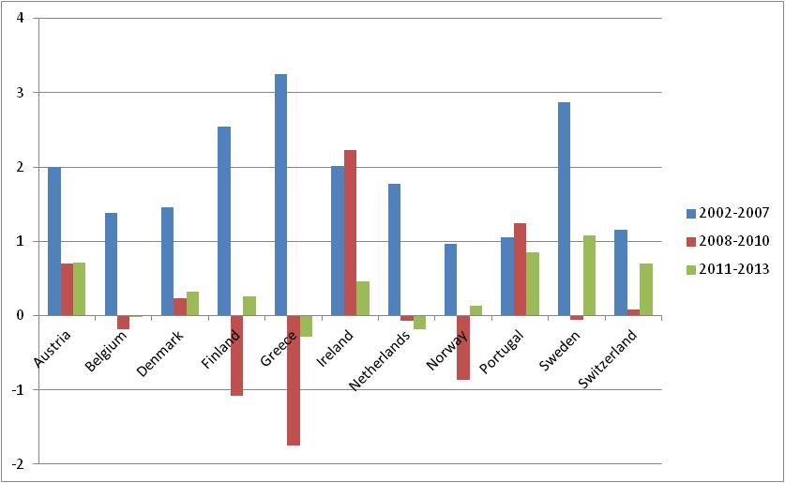
Small and medium sized European Countries: Annual hourly productivity growth % (Source: OECD)

Slide 4
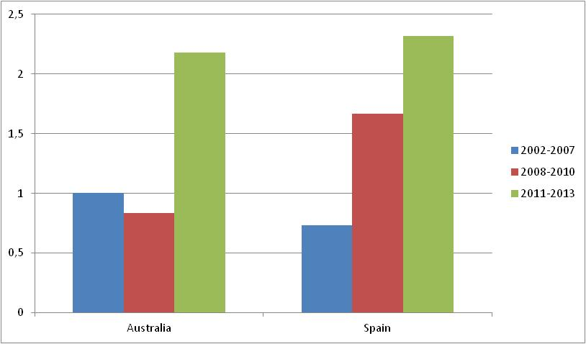
Two major exceptions: Australia… and Spain
Annual hourly productivity growth % (Source: OECD)

Slide 5
Why puzzling?
A multi-factor productivity slowdown (or recovery), as well
For most countries, large contrasts compared to previous recessions
No straightforward explanations
Large uncertainty on the future of (productivity) growth
Surprising unemployment figures

Slide 6
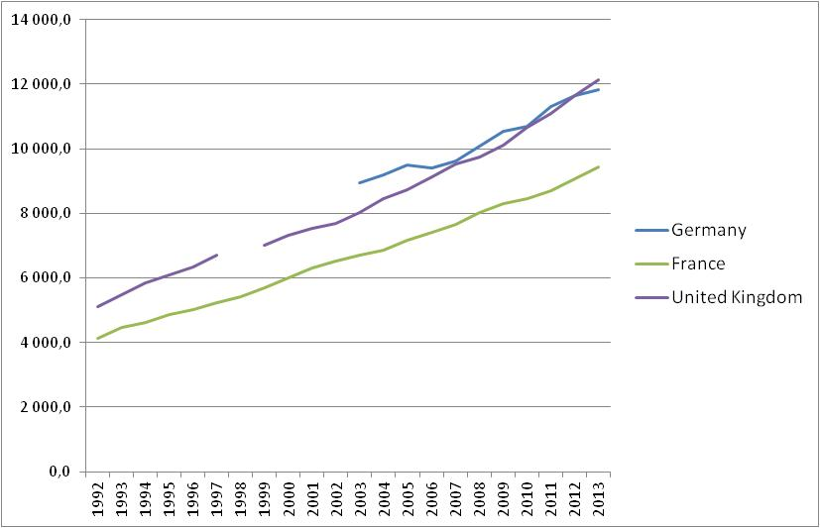
Eg. The rise in tertiary-educated employment was in general unaffected by the crisis. 1000s France, Germany, UK (EU LFS)

Slide 7
Many open questions
Mismeasurements?
The signs of a secular stagnation or of faltering innovations?
Or a transitory phenomenon?
A common story for Europe or a sum of coincidences?
The roles of various shocks: financial and debt crises, labour market policies, demographic transition

Slide 8
Today
Morning session: Global views
Afternoon sessions: the cases of the 3 largest European economies –France, Germany, United-Kingdom- and the “outlier” Spain

