Slide 1
The German Labor Market Puzzle in the Great Recession
Productivity Puzzles in Europe
January 23rd 2015
Cepremap,
ENS, Paris
Lutz Bellmann
Hans-Dieter Gerner
Marie-Christine Laible
Notes:
Tipps für die Nutzung der Titelfolie
Der Titel ist optimiert für 1-2 Zeilen.

Slide 2
Motivation
Deviation from established patterns in the Great Recession
usually:
employment path mirrors changes in GDP with a delay
breaks in pattern:
severe deline of GDP coupled with stable employment
demand shock affecting mainly the manufacturing sector
What makes the German case different?
labor market puzzle
„Germany‘s job miracle“
short-lived crisis

Slide 3
Outline
Macro-economic trends
Germany‘s job miracle
Labor market institutions
pacts for competitiveness and employment
Micro-economic evidence
Lessons learned
Conclusion

Slide 4
Germany‘s GDP per head (1991-2012)
Notes: Prices in 2005 in 1000€
Source: Statistisches Bundesamt
Take-away:
relatively stable upward pattern
upswing prior to 2008/2009
severe decline in 2009: -6.6% from its peak in 2008
quick recovery

Slide 5
Germany‘s quarterly unemployment rate (2006-2013)
Notes: Seasonally adjusted unemployment rate for selected countries.
Source: Eurostat.
Take-away:
comparably high unemployment rate in 2006: 10.6%
steady decline
2009Q4: 7.7% compared to Spain (18.9%), France (9.6%) and USA (9.9%)
lowest in Europe in 2013Q4: 5.2%
Notes:
reasons for decline in unemployment rate prior to crisis discussed later

Slide 6
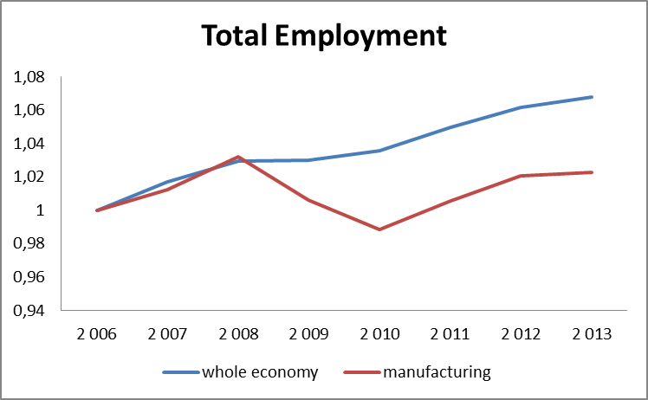
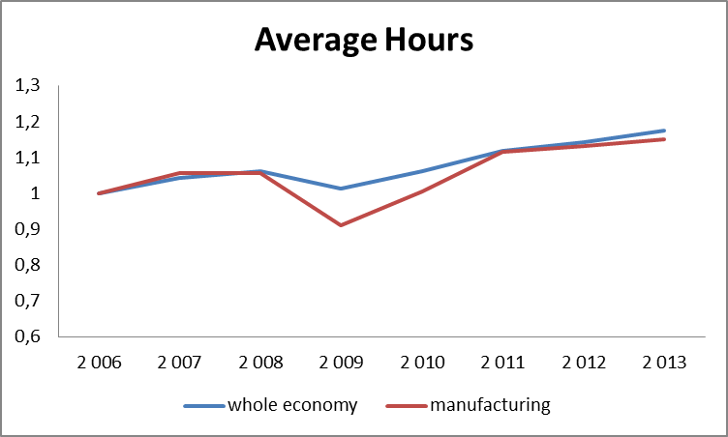
The manufacturing sector (I)
Notes:
Notes. Differences between manufacturing and the whole economy 2006-2013. GVA, employment and hours indexed 2006-100.
Highly productive and innovative exporting manufacturers were able to take advantage of two circumstances: First, they had benefited from an upswing in international demand prior to the crisis. Second, due to the quick recovery of Asian economies, they could take advantage of a post-crisis demand increase for German products (Bornhorst & Mody, 2012). While most of Germany’s trade takes place within the European Union (EU27: 59 percent; Europe: 71 percent), Asia is responsible for 16 percent of all German exports and China was Germany’s fifth largest trade partner in 2011 after France, the USA, the Netherlands and the UK (Statistisches Bundesamt, 2011). Therefore, Germany indirectly profited from China’s stimulus packages of four trillion yuan, mainly to be spent on the construction of infrastructure (Barboza, 2008).
Thus, overall, the Great Recession in Germany mainly manifested as a transitory external demand shock - including a sharp decline in exports – with a rather quick recovery.
Firms engaging in international trade are considered a positive selection which is more productive and innovative compared non-exporting firms (Wagner, 2011).

Slide 7
The manufacturing sector (II)
Great Recession mainly affected manufacturers and exporters
18% drop in GDP for manufacturing sector in 2009
few spill-over effects to service sector
positive selection of firms (high pre-crisis competitiveness)
bailout packages aimed at these industries („Abwrackprämie“)
demand shock with limited duration → post-crisis demand from Asian countries
strategic labor hoarding due to shortage of skilled workers

Slide 8
Transitory external demand shock
CES ifo Group Munich surveys over 7.000 firms in manufacturing, construction, wholesale, retail
expectations (more favourable, unchanged, less favourable) for the following six months
→ firms expected crisis to be short-lived!
Notes:
index can fluctuate between -100, i.e. all firms expect the business climate to become worse, and +100, i.e. all firms expect the business clime to improve

Slide 9
Germany‘s Labor Market Puzzle

Slide 10
The Hartz Reforms (2003-2005)
1990s: low GDP growth and high unemployment rates → labor market reform
restructured labor market with new incentives for unemployed to seek jobs
Hartz IV laws replaced unemployment benefits and social assistance
cut of maximum duration of benefit entitlement
Results:
increased labor market flexibility
increased employment growth
increased effectiveness of labor market
decreased unit labor costs
increased international competitiveness
allowed firms to build up financial reserves
favorable pre-crisis conditions

Slide 11
Short-time work
overcome “temporary, unavoidable loss of work due to economic factors or unavoidable incident“ (§§ 101-111 Social Code III)
peak: 2009/Q3
approx. 63,000 establishments (3 %)
approx. 1.4 million employees (3 %)
approx. costs for Federal Employment Agency: 5 billion €
but: by 2009/Q4 number of employees reduced by half
positive impact on employment revealed by Boeri/Bruecker (EP 2011)
existence of short-time work stabilizes (Balleer et al., 2014)
unemployment fluctuations by 15%
output fluctuations by 7%

Slide 12
Industrial relations
Germany‘s multi-level bargaining structure
pact for employment and competitiveness (PEC)

Slide 13
Pacts for employment and competitiveness (PEC) – institutional background
PECs (usually) include concessions from both the employer‘s and the employee‘s side (gift exchange)
PECs mostly include concessions concerning wages and working time
for example works councils agree to firm-specific deviations from industry-level bargaining contracts, f.ex. reduced wages in exchange for employment guarantees
Take-away from the Great Recession:
cooperation between social partners as one of Germany‘s most important reactions to the crisis

Slide 14
Reasons for Germany‘s job miracle
pre-crisis reforms helped flexibilize the labor market and pushed firms to competitiveness
favorable institutions were already in place before the crisis and could be taken advantage of
social partners willingness to cooperate in crisis time

Slide 15
Data overview
IAB-Establishment Panel Survey
representative survey of Germany‘s labor demand
all industries, Bundesländer and establishment sizes
since1993 (West) and 1996 (West +East)
face-to-face interviews with high response rate
sample drawn from all establishments with at least one employee subject to social security as of June 30th of the previous year
establishment = regionally and economically separate unit
annual questions + questions with current relevance
Sample
1993-2013
private sector

Slide 16
Labor productivity development over time
Dependent variable: natural logarithm of revenue per worker | Basic equation | incl. control variables | For manufacturing industry incl. control variables
2000 | -0,057 (0,008) | -0,050 (0,011) | -0,070 (0,016)
2001 | -0,056 (0,008) | -0,050 (0,010) | -0,068 (0,015)
2002 | -0,048 (0,008) | -0,044 (0,009) | -0,073 (0,014)
2003 | -0,027 (0,007) | -0,018 (0,009) | -0,038 (0,014)
2004 | -0,024 (0,007) | -0,004 (0,011) | -0,011 (0,015)
2005 | -0,010 (0,006) | -0,003 (0,008) | 0,009 (0,013)
2006 | 0,033 (0,006) | 0,045 (0,007) | 0,074 (0,012)
2007 | 0,037 (0,005) | 0,037 (0,005) | 0,089 (0,008)
2008 | 0,040 (0,005) | 0,043 (0,005) | 0,090 (0,008)
2009 | Base category
2010 | 0,033 (0,004) | 0,040 (0,004) | 0,084 (0,007)
2011 | 0,068 (0,005) | 0,071 (0,005) | 0,120 (0,008)
2012 | 0,067 (0,005) | 0,068 (0,005) | 0,107 (0,008)
Number of firms | 23.436 | 16.967 | 5.636
F-value | 42,57 | 26,57 | 23,79

Slide 17
Establishment-level PECs in 2008
Incidence of PECs is higher in establishments
which are larger
affected by the crisis
with a bad profit situation
highly involved in the system of industrial relations
Establishment size | Incidendence in %
1-10 employees | 0.5
11-50 employees | 2.4
51-100 employees | 8.4
101-250 employees | 11.9
251-500 employees | 24.0
> 500 employees | 34.5
Overall | 1.4

Slide 18
Labor productivity and PECs
Dependent variable: natural logarithm of revenue per worker | FE 2008/2009 without control variables | FE 2008/2009 with control variables | FE 2008/2009 with control variables, manufacturing industry
Time dummy 2009 | -0,043 (0,005) | -0,048 (0,005) | -0,105 (0,008)
Interaction time dummy 2009 and company level pact 2008 | -0,077 (0,017) | -0,089 (0,020) | -0,090 (0,026)
Number of establishments | 7,358 | 6,832 | 2,387

Slide 19
Employment adjustments and PECs
 | FE without controls 2008/2009 | FE with controls, 2008/2009 | FE with controls, 2008/2009, manufacturing industry
$$β_{1}^{n}$$ | 0.042 (0.018) | 0.047 (0.016) | 0,064 (0,022)
$$β_{2}^{n}$$ | -0.025 (0.035) | -0.013 (0.039) | 0,017 (0,048)
$$γ_{1}^{n}$$ | 0.055 (0.013) | 0.068 (0.015) | 0,056 (0,015)
$$γ_{2}^{n}$$ | -0.045 (0.025) | -0.058 (0.027) | -0,038 (0,024)
$$α^{n}$$ | 0.019 (0.002) | -0.016 (0.029) | 0,003 (0,032)
Number of establishments | 7,358 | 6,832 | 2,387
$$∆n_{it}= α^{n}+β_{1}^{n}\left(∆y_{it}∙1\left(∆y_{it}>0\right)\right)+γ_{1}^{n}\left(∆y_{it}∙\left(∆y_{it}<0\right)\right)+$$
$$β_{2}^{n}\left(∆y_{it}∙1\left(∆y_{it}>0\right)∙PEC\right)+γ_{2}^{n}\left(∆y_{it}∙\left(∆y_{it}<0\right)∙PEC\right)+$$
$$α_{i}^{n}+D_{t}^{n}+ε_{it}^{n}$$
$$∆n_{it}:emploment change (from t−1 to t)$$
$$∆y_{it}:revenue change \left(from t−1 to t\right)$$
$PEC:dummy (=1, if firm has a PEC in 2008$

Slide 20
Lessons Learned
transference of best practices limited because:
favourable pre-crisis conditions
timing of reforms for labor market flexibility
prior upswing
stability and competitiveness of firms prior to crisis
nature and duration of Great Recession
manufacturing sector
temporary demand shock
remarkable willingness of all parties involved to cooperate

Slide 21
Conclusion
interaction of many reasons responsible for Germany‘s job miracle
nature and duration of crisis very specific
labor hoarding as extensive phenomenon in the crisis
multi-level collective bargaining system deemed key in Germany‘s success story
willingness to cooperate
flexibility achieved through company-level pacts for employment
firms making use of labor hoarding were able to recuperate quickly and „bounce back“ after the demand shock lessened
overall productivity may benefit from employment stability

Slide 22
Thank you!
Lutz Bellmann
lutz.bellmann@iab.de
Hans-Dieter Gerner
hans-dieter.gerner@iab.de
Marie-Christine Laible
marie-christine.laible@iab.de

Slide 23
Backup

Slide 24
Within-firm flexibilities
labor hoarding through
short-time work
depletion of working time accounts
company-level pacts for employment
reasons:
labor market legislation (employment protection)
perceived shortage of skilled workers
expectation of a temporary demand shock
→ tool to retain skilled workers and resume high productivity in upswing

Slide 25
Working-time accounts
agreed upon by collective bargaining agreements
temporary deviation from average weekly working time
large surplusus (upswing in 2005-2007)
save labour costs
retain employees

Slide 26
Company-level pacts for employment and competitiveness (2)
Advantages | Disadvantages
reduction of labour costs and thus increase of employees | promises made may be hard to keep when economic situation deteriorates
increase in labour productivity through flexible working time regulations and reorganizations | distortion of labour markets: insiders are favoured because of layoff restrictions and employment prospects of outsiders are worsened
aids survival of firms, saves jobs and thus fosters employment | exaggerated employment expectations going against market trends
deviations from collective agreements are restricted because unions would not agree otherwise | erosion of industry-level collective agreements
social partners are encouraged to take more responsibility for employment issues
Source: Bellmann (2014).

