Slide 1
Productivity puzzles in europe: the french and british conundrums
Dan Andrews
Senior Economist
Structural Policy Analysis Division
Economics Department
Organisation for Economic Co-operation & Development
CEPREMAP Conference | 23 January 2015

Slide 2
General comments
2 interesting papers that use workplace surveys to investigate common factors, including labour hoarding and returns to Org K.
Evidence of upskilling and labour hoarding in both countries. Can we say more about the cyclical insensitivity of skilled labour?
Matching models posit an inverse relationship between skill and employment volatility (Cairo & Cajner, 2014; Lugauer, 2012).
Investments in firm-specific training complementary with skill
Upskilling → ↑ training → ↑ cost of employment adjustment for firms and workers → ↓ volatility in response to shocks
More discussion on the:
Potential role of reallocation (there is a big “within-firm” focus).
Implications of slowing KBC investment (i.e. fewer spillovers).
Notes:
- High loss of firm specific HK upon separation for highly skilled-trained/productive workforce
- Harder for firms to replace/rebuild high value job matches, which lowers firm’s options to adjust employment

Slide 3
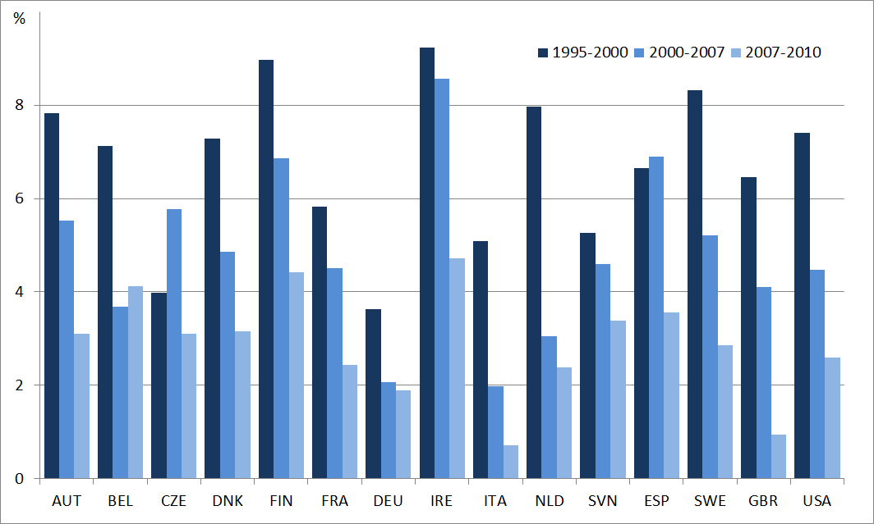
Investment in knowledge-based capital has slowed…
Investment in KBC; average annual growth
KBC is often non-rival → MFP spillovers
Source: calculations based on Corrado et al., (2012).

Slide 4
France – can we develop the story more?
Transitory factors:
1. Rising skills + insensitivity to cycle (~ ½): can we say more?
2. Lower returns to Org K: measurement issues?
Workplace practices differ to the Bloom et al indicators (monitoring, targets, incentives) that causally impact productivity.
Burden of labour market regulations increases at 50+ employees (Garicano et al., 2013). Relevant for “Employee Voice”?
No evidence of lower returns to Org K in the UK paper.
Permanent factors:
3. Auto-entrepreneurs reform → ↑ self employment. Channels: informality; allocative efficiency: firm size & productivity should be positively correlated.
4.↑ short term work contracts: econometric result not very strong. Temporary jobs: “stepping-stones” or “traps”?
Notes:
WP statistically significant in 2005 but not 2011 – what does this mean??

Slide 5
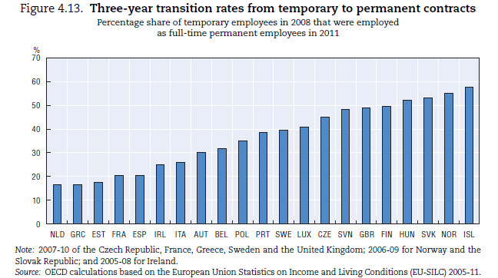
Low transition rates from temporary to permanent contracts in France…
Source: OECD (2014), Employment Outlook.
Notes:
Stepping stones or traps: It turns out that it varies across countries

Slide 6
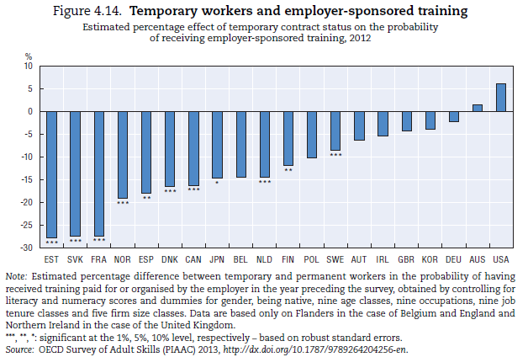
… may reflect reduced probability of training in temporary jobs…
Source: OECD (2014), Employment Outlook.

Slide 7
United Kingdom: taking a stronger stand on the existing literature
1. Nice literature review but the lack of consensus over seemingly basic facts is concerning (e.g. capital vs MFP?).
Why do Pessoa & Van Reenen (2014) find something different to the others?
Conference Board: bigger decline in MFP than LP since 2007.
2. Can we say more about the role of reallocation?
Cleansing effect of the crisis (i.e. “killing the weakest”) is consistent with OECD research on employment dynamics.
Notes:
Why do Pessoa & Van Reenen (2014) find something different to Field & Franklin (2014) and Harris & Moffat (2014)?
Conference Board: in 2013 vs 2007, level of labour productivity (LP) is 3% lower, while MFP is 8.7% lower.
Other issues
- Measurement: self-reported labour productivity; why not match survey indicators with industry level productivity?

Slide 8
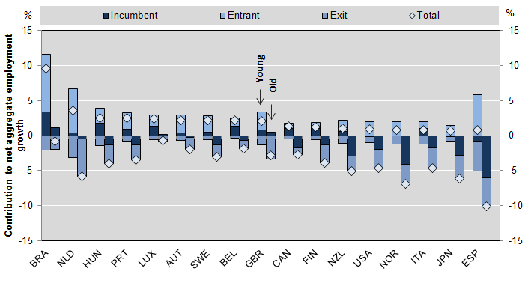
Old firms shed more jobs than young firms during the crisis
Contribution of young and old firms to net aggregate employment growth
By margin of adjustment, as % of aggregate non-financial business sector employment; 2007-2010
Source: C. Criscuolo, P. N. Gal and C. Menon (2014), “The Dynamics of Employment Growth: New Evidence from 18 Countries”, OECD Science, Technology and Industry Policy Papers no. 14.
Notes:
Older firms tend to be less productive

Slide 9
United Kingdom: taking a stronger stand on the existing literature
1. Nice literature review but the lack of consensus over seemingly basic facts is striking (e.g. capital vs MFP?).
Why do Pessoa & Van Reenen (2014) find something different to the others?
Conference Board: bigger decline in MFP than LP since 2007.
2. Can we say more about the role of reallocation?
Cleansing effect of crisis (i.e. killing the weakest) is consistent with recent OECD research on employment dynamics.
2008-09 is a within-firm story BUT what’s driving the changing contribution from reallocation?
Notes:
Why do Pessoa & Van Reenen (2014) find something different to Field & Franklin (2014) and Harris & Moffat (2014)?
Conference Board: in 2013 vs 2007, level of labour productivity (LP) is 3% lower, while MFP is 8% lower.
Other issues
- Measurement: self-reported labour productivity; why not match survey indicators with industry level productivity?

Slide 10
What’s driving the sizeable pre-crisis contribution from reallocation?
= Reallocation across incumbents + net entry
Massive in the context of the
existing literature…
Notes:
Collapse in LP growth in 2008-09 is a within-firm story which motivates WERS analysis…
BUT the step-down in LP growth from 2004-07 to 2010-12 reflects both, but particularly a reallocation story.
The contribution from reallocation during 2004-07 is very large relative to what you usually see in the literature: apart from episodes of dramatic structural reform (e.g. Eastern Europe), the contribution from reallocation is usually dwarfed by within firm effects over short windows, but over the longer term (i.e. 10 year windows), the relative contribution from reallocation rises.
What’s causing this? More info on the components (i.e. reallocation across incumbents vs net entry) would be nice.
If it’s a one-off factor, maybe we are less concerned?
“Trade induced technical change?” by Bloom, Draca & Van Reenen
- Chinese competiton generated both within-firm and reallocation effects: in sectors more exposed to Chinese imports, jobs and survival rate fell in low-tech firms (e.g. lower patenting
intensity), but high-tech firms were are relatively sheltered (the between firm effect).

Slide 11
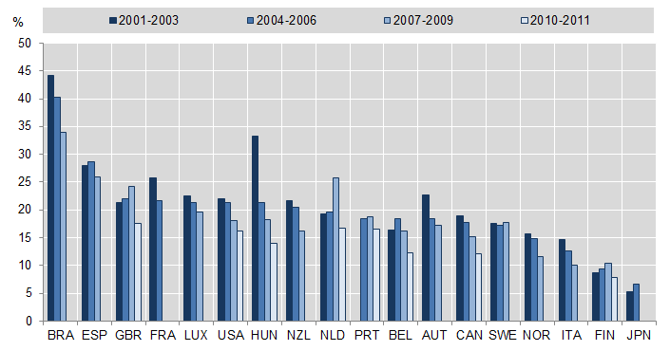
An entry story?
Declining start-up rates across OECD countries
Entry directly affects reallocation and indirectly within-firm productivity by placing pressure on incumbents to innovate (+ less radical innovation in the future).
Source: C. Criscuolo, P. N. Gal and C. Menon (2014), “The Dynamics of Employment Growth: New Evidence from 18 Countries”, OECD Science, Technology and Industry Policy Papers no. 14.
Notes:
It could also be an entry story….

Slide 12
Some issues for future of productivity
Structural issues
Within-firm and reallocation components improve aggregate MFP forecasts, even when firm-level data are available with a time lag (Bartelsman & Wolf, 2014).
Broad-based slowdown across all firms? Or does it vary with distance to the frontier? What’s happening at the global and national frontiers?
Why don’t seemingly non-rival technologies and best organisational practices diffuse to all firms in the economy?
Resource misallocation remains an issue (esp. skills: 20-25% of workers report skill mismatch in FRA and GBR).
Notes:
Looking fwd:
The results from these productivity decompositions are useful because…
Slowdown; Broad-based across all firms?
Key question: why don’t seemingly non-rival technologies and best HRM practices diffuse to all firms in the economy? (Table 6 of UK paper). Worrying given complementarities with ICT.
Declining business dynamism and entry → less radical innovation & pressure on incumbents to innovation (not captured in FKH decomposition)

Slide 13
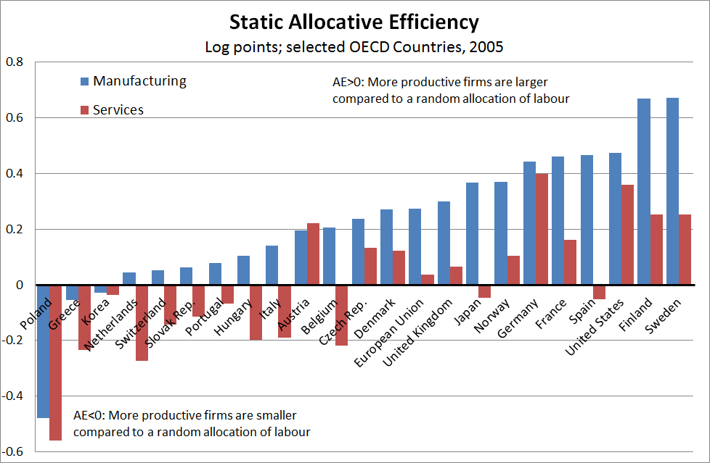
Significant scope to improve efficiency of resource allocation, esp. in services
Notes: The estimates show the extent to which firms with higher than average labour productivity have larger employment shares. For example, productivity in the manufacturing sector in the US is around 50% higher due to the actual allocation of employment, compared to a baseline in which labour is allocated randomly across firms (AE=0).
Source: Andrews, D and F. Cingano (2014), “Public Policy and Resource Allocation: Evidence from firms in OECD countries”, Economic Policy 29(78), pp. 253-296.

Slide 14
Some issues for future of productivity
Policy issues
Addressing labour market dualism in FRA: i) ban short-term contracts; ii) reduce EPL on regular contracts; iii) single contract; or iv), unified contract? See OECD Employment Outlook – 2014.
Obsession with small firms can lead to bad public policy.
We rarely talk about the exit margin: efficiency of R&D tax incentives enhanced by lower exit costs (Acemoglu et al., 2014).
Notes:
Another way to alleviate labour market dualism is to foster convergence towards a common level of termination costs between the different types of contracts by making regulation as homogeneous as possible across contractual relationships. In principle, the level of termination costs could be chosen in a way that matches each country’s social and political preferences for worker protection, thus not necessarily implying convergence towards low degrees of employment protection. Full convergence could be achieved through the introduction of either a single contract – with termination costs increasing with job tenure and applied to all workers, while suppressing or limiting all fixed-term contracts – or a unified contract – with the same termination costs applying to all contracts, independently of whether they are permanent or temporary. However, their implementation would require in many countries addressing a number of difficult and contentious issues – such as extending the definition of fair dismissal and limiting the judicial review of the dismissal decision to discrimination, prohibited grounds and
false reasons. Moreover, suppressing all fixed-term contracts would run the risk of reducing hiring and fostering the use of contracts for individual labour services regulated by commercial law – that is an even less protected form of employment.
Given the difficulty of their implementation, it is perhaps not surprising that there are no country examples of the use of a single contract and only fewexamples in the case of a unified
contract. Ireland, New Zealand and the United Kingdom have implemented a significant convergence of termination costs across contracts, while maintaining various forms of temporary contracts to provide firms with the necessary flexibility, especially to deal with truly temporary activities. However, these countries have all low degrees of employment

Slide 15
Spares
Notes:
Key question: why don’t seemingly non-rival technologies and best HRM practices diffuse to all firms in the economy? (Table 6 of UK paper). Worrying given complementarities with ICT.
Declining business dynamism and entry → less radical innovation & pressure on incumbents to innovation (not captured in FKH decomposition)

Slide 16
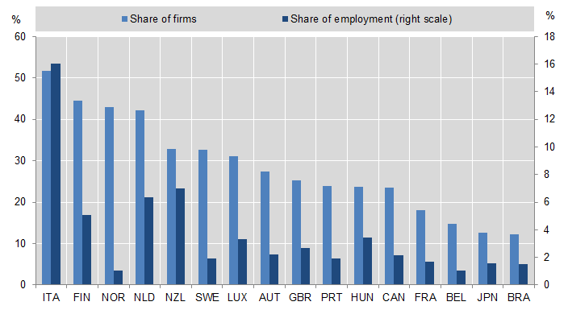
Lots of really small firms already: why do we want more??
Share of employment in firms never growing above one employee
Services
Source: C. Criscuolo, P. N. Gal and C. Menon (2014), “The Dynamics of Employment Growth: New Evidence from 18 Countries”, OECD Science, Technology and Industry Policy Papers no. 14.

